Slide 1
Fall 2017 Training:
e-Resources
Authentication
TrueFLIX
BookFLIX
This project is made possible by a grant from the Institute of Museum and Library Services as administered by Pennsylvania Department of Education through the Office of Commonwealth Libraries, and the Commonwealth of Pennsylvania, Tom Wolf, Governor.

Slide 2
Learning Goals
At the end of this session you will be able to
Update links for proper e-resource authentication
Troubleshoot common issues after updating links
Navigate the TrueFLIX interface
Browse titles by Title, Subject, Category, Lexile, and ATOS Readability
Locate the following for each selection:
Pre-made lesson plans
Web resources
Downloadable materials for libraries and classrooms
Navigate the BookFLIX interface
Browse titles by Title, Author, Illustrator, Lexile, etc.
Locate the following for each selection:
Pre-made lesson plans
Web resources
Downloadable materials for libraries and classrooms

Slide 3
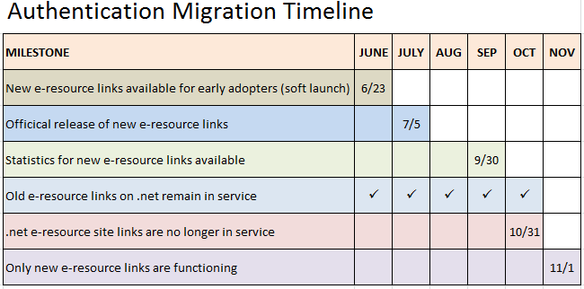
e-Resource Authentication

Slide 4
e-Resource Authentication
Obtain your new e-resources links from the link generator:
http://www.powerlibrary.org/librarians/e-resources/e-resources-links/
Old links will no longer work beginning November 1, 2017
TrueFLIX is only available using the new authentication links
Desktop icons should be updated on all computers
If unable to do so by self, see IT department or whomever is in charge of updating
Use Support form if help is needed
Why should my library switch to the new URL as soon as possible?
Access to Scholastic’s TrueFLIX, the new e-resource provided by the Office of Commonwealth Libraries, will only be available to libraries that update to the new URL. Additionally, popular EBSCO e-resources Web News and Newswires are now available directly from the list of e-resources for those that switch to the new URL. Finally, remote access statistics (for public libraries) for some e-resources will only be available by using the new URL.

Slide 5
For Librarians Page: Obtain new links
Notes:
For Librarians page→ Obtain new links for your library

Slide 6
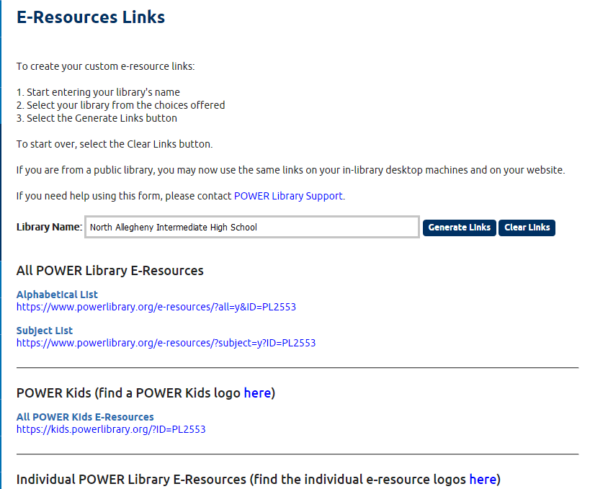
New Links
Test links from this page first before changing on site.
Any Powerlibrary.net links need to be changed ASAP as they will no longer work after 10/31/17.
Notes:
Enter school name, click generate links
Links, logo, links to individual resources included

Slide 7
Having Trouble?
1. Don't panic! - the deadline is now October 31st and we can help you! 2. Know who your IT people are (gather contact info in case it's needed). 3. Test the e-resources links before changing your website. 4. Test the e-resources links from computers on-site that should have access (library computers, teacher computers, computer labs, etc.). 5. Know your IP address. If you're unsure you can visit www.whatsmyip.com 6. Please fill out the support form which will allow us to assist you in the best way possible.

Slide 8
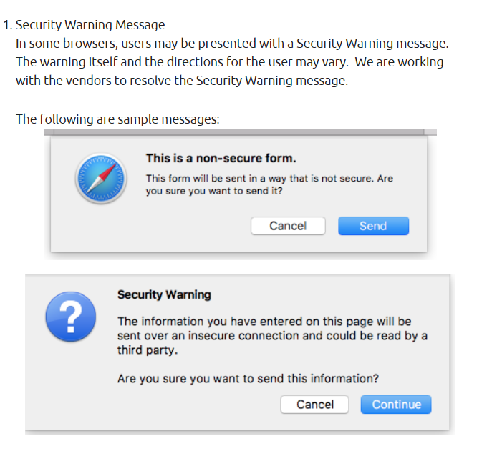
Known Issues: BookFLIX and TrueFLIX Security Warning

Slide 9
Known Issues: EBSCO Resources
If you receive an error message when trying to access EBSCO resources please contact HSLC Support.

Slide 10
Known Issues: Asking for eCard
After updating links, some libraries are being asked to enter an eCard or library barcode number to access the resources.
If you are accessing e-Resources on-site, you should not be asked for an eCard.
Please contact us to confirm we have the correct IP address range

Slide 11
Known Issues: Asking for username and password

Slide 12
Known Issues: Asking for username and password

Slide 13
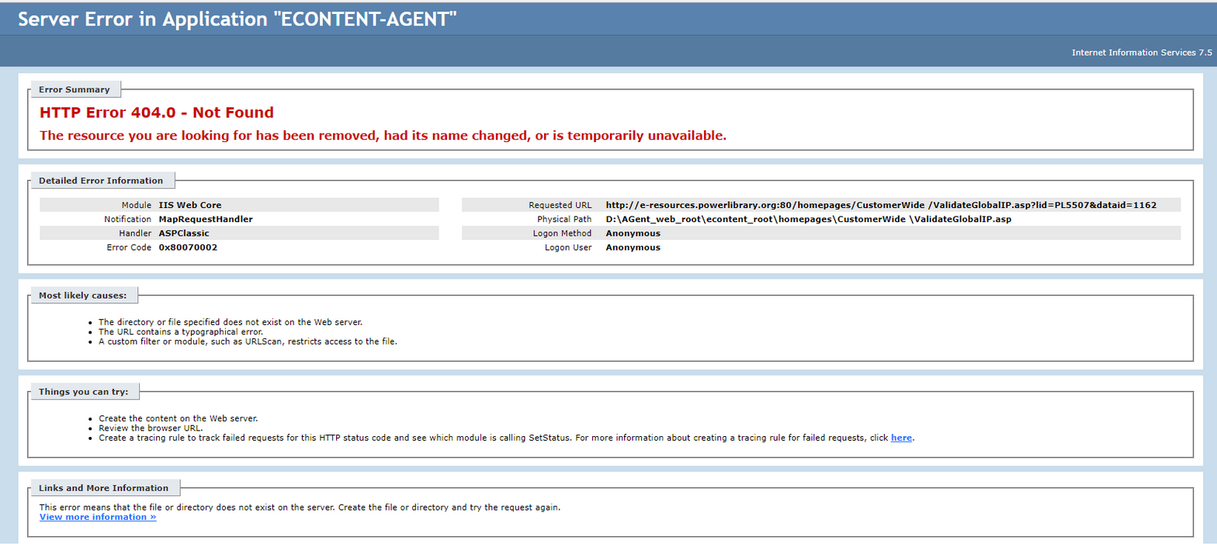
Known Issues—Authentication Fail
Notes:
Can’t find the database—backend vendor issue

Slide 14
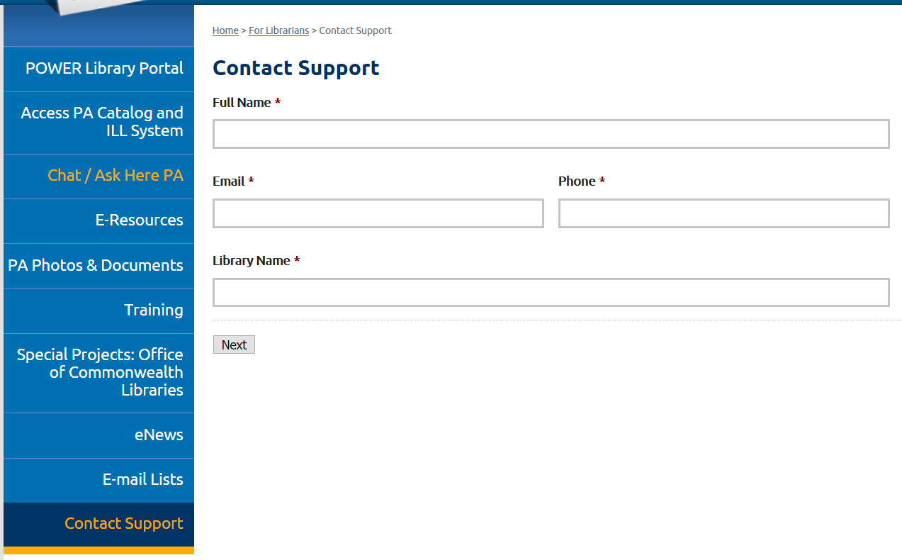
Contacting Support
For Librarians page on POWER Library website
Bottom link on left menu “Contact Support”

Slide 15
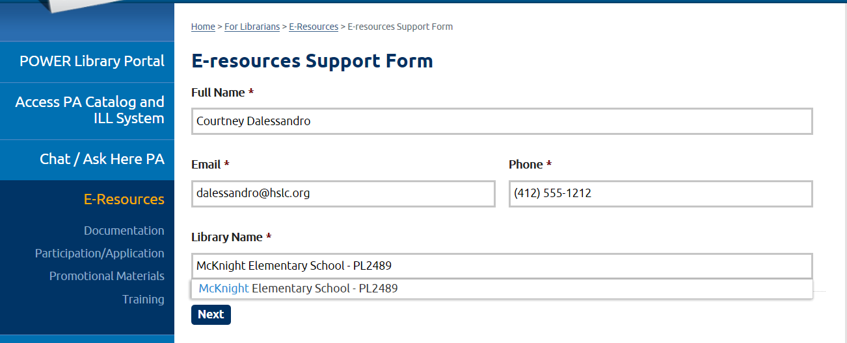
e-Resources Support Form
E-resource support form will walk you through the submission of a Help Desk ticket.

Slide 16
e-Resources Support Form

Slide 17
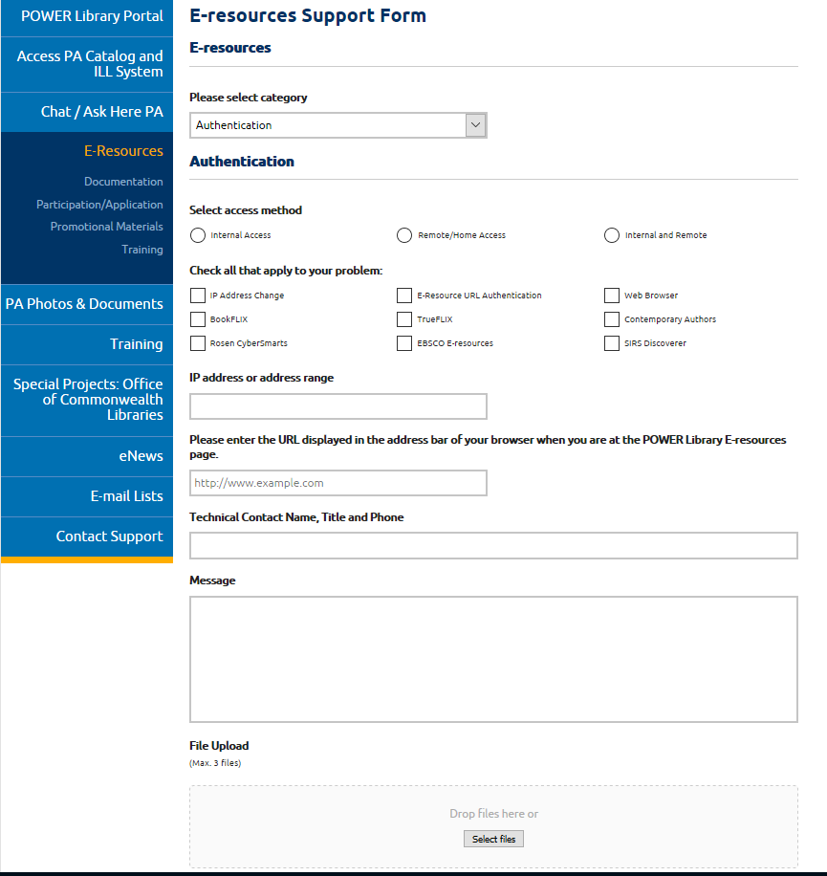
e-Resources Support Form
If you are unsure of your IP range, please contact your tech support department.

Slide 18
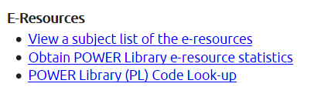
Statistics
New statistics will be released late fall 2017. Look for announcements of free webinars and recorded videos on the topic. In the meantime, can use current statistics via the For Librarians page.
https://www.powerlibrary.org/librarians

Slide 19
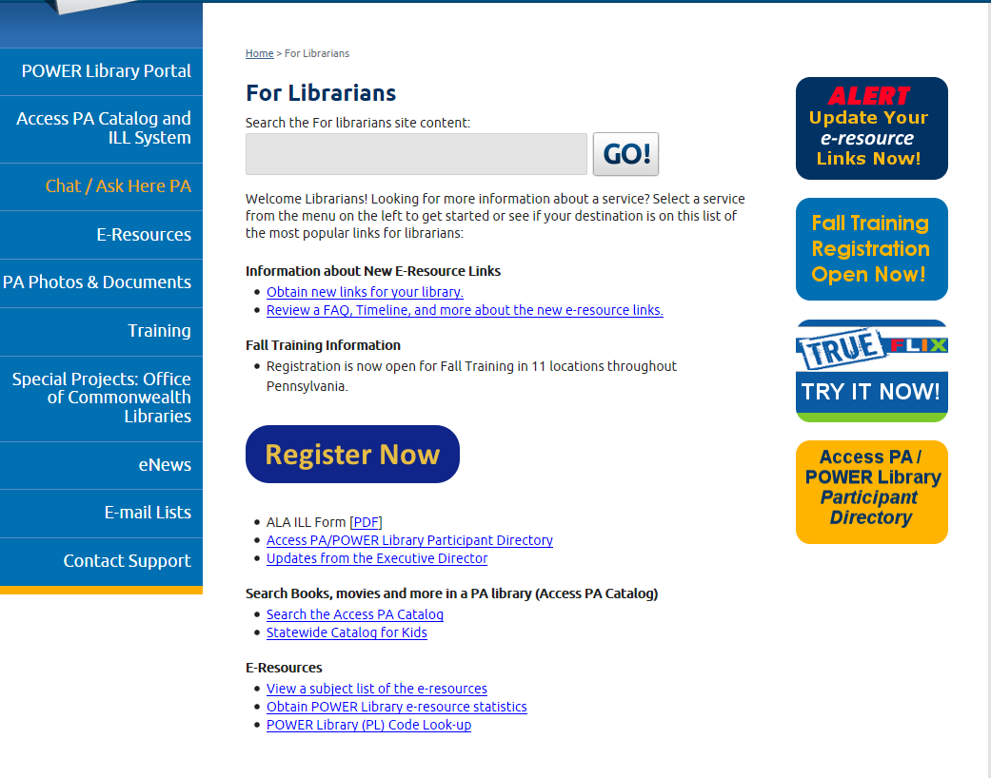
For Librarians Documentation

Slide 20
Questions on e-Resource authentication?

Slide 21
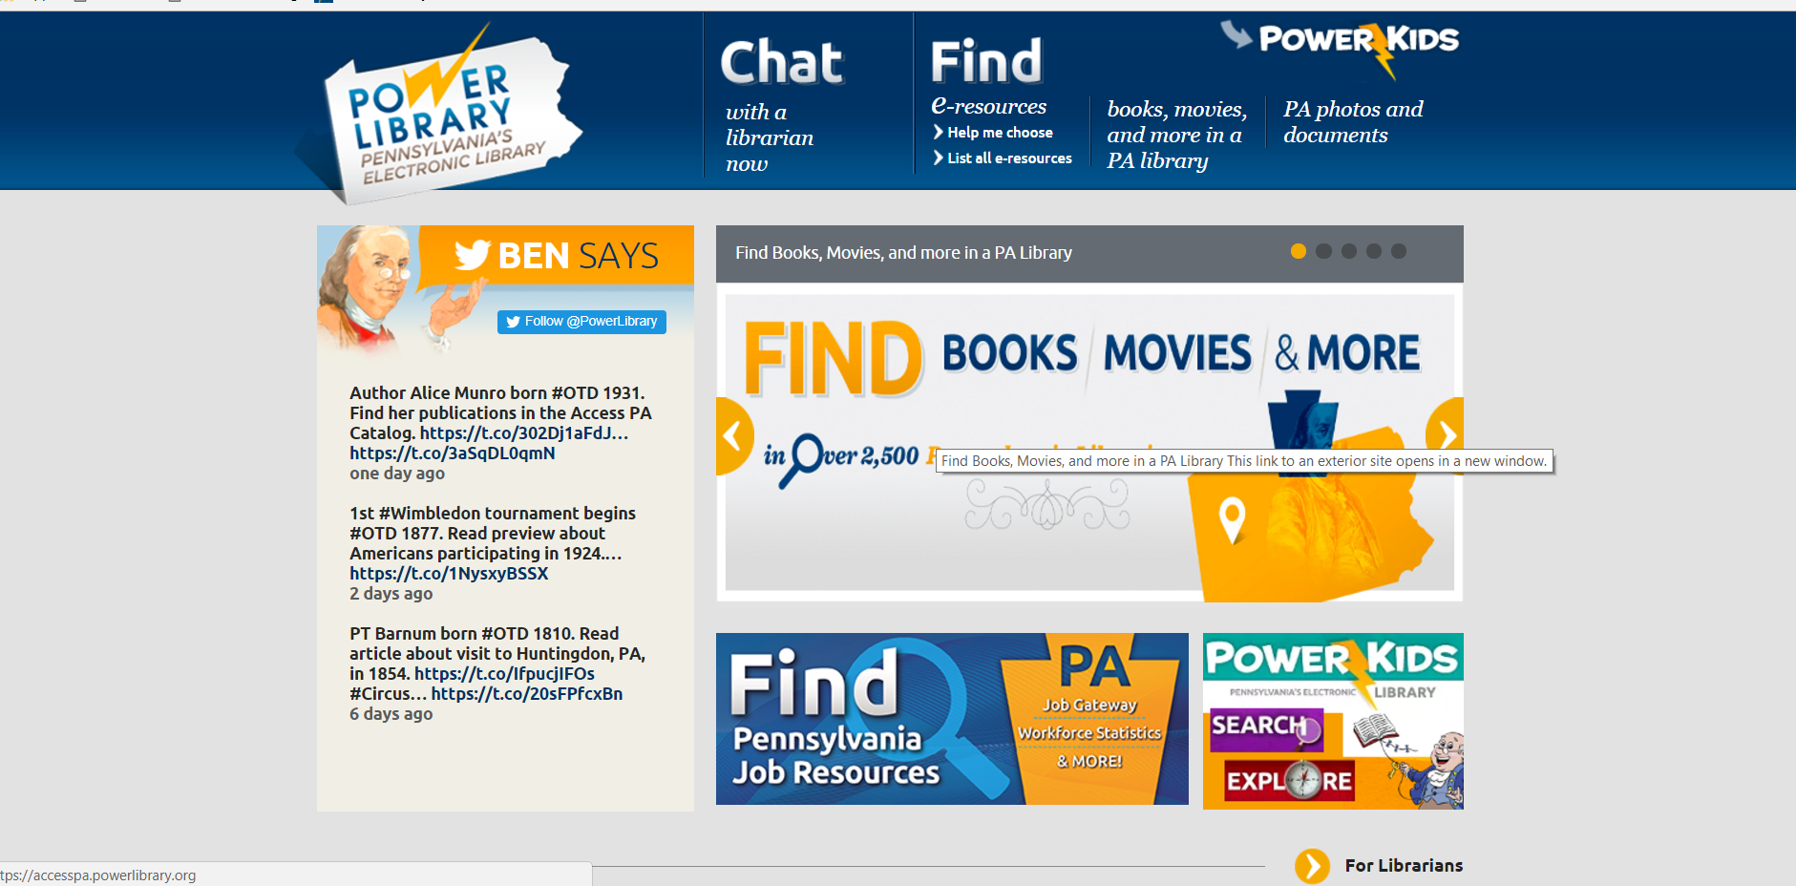
Notes:
From main page, 2 ways to access e-resources

Slide 22
Digital Social Studies and Science units
Contains 140 titles (MARC records available for download)
For children grades 3 through 6
Unlimited, simultaneous access
Promotes the instruction and development of 21st Century information literacy skills
Built-in lesson plans and project ideas
Desktop icon and webpage buttons are available for easy access

Slide 23
Notes:
TrueFLIX features

Slide 24
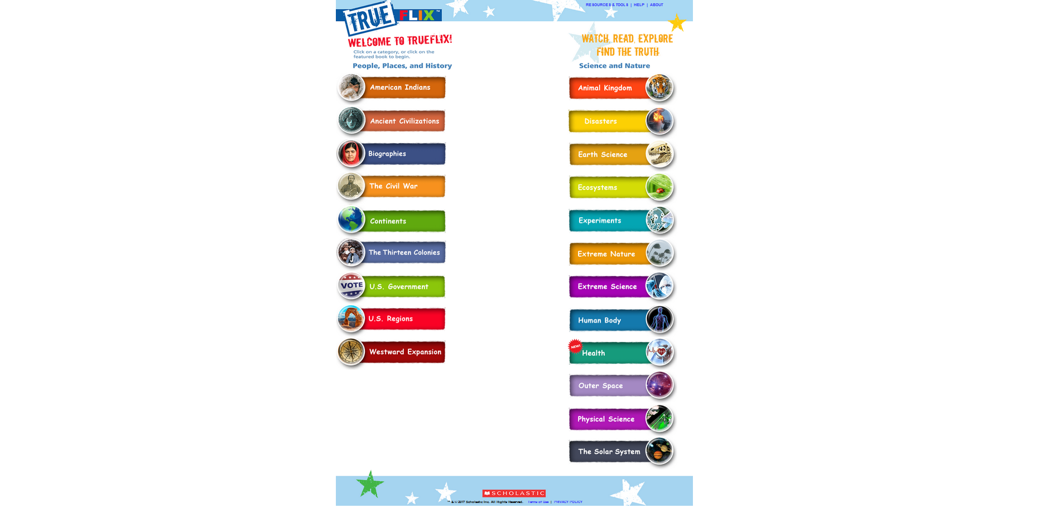
TrueFLIX Units
Social Studies Units
Science Units
Notes:
Units are categorized by content area

Slide 25
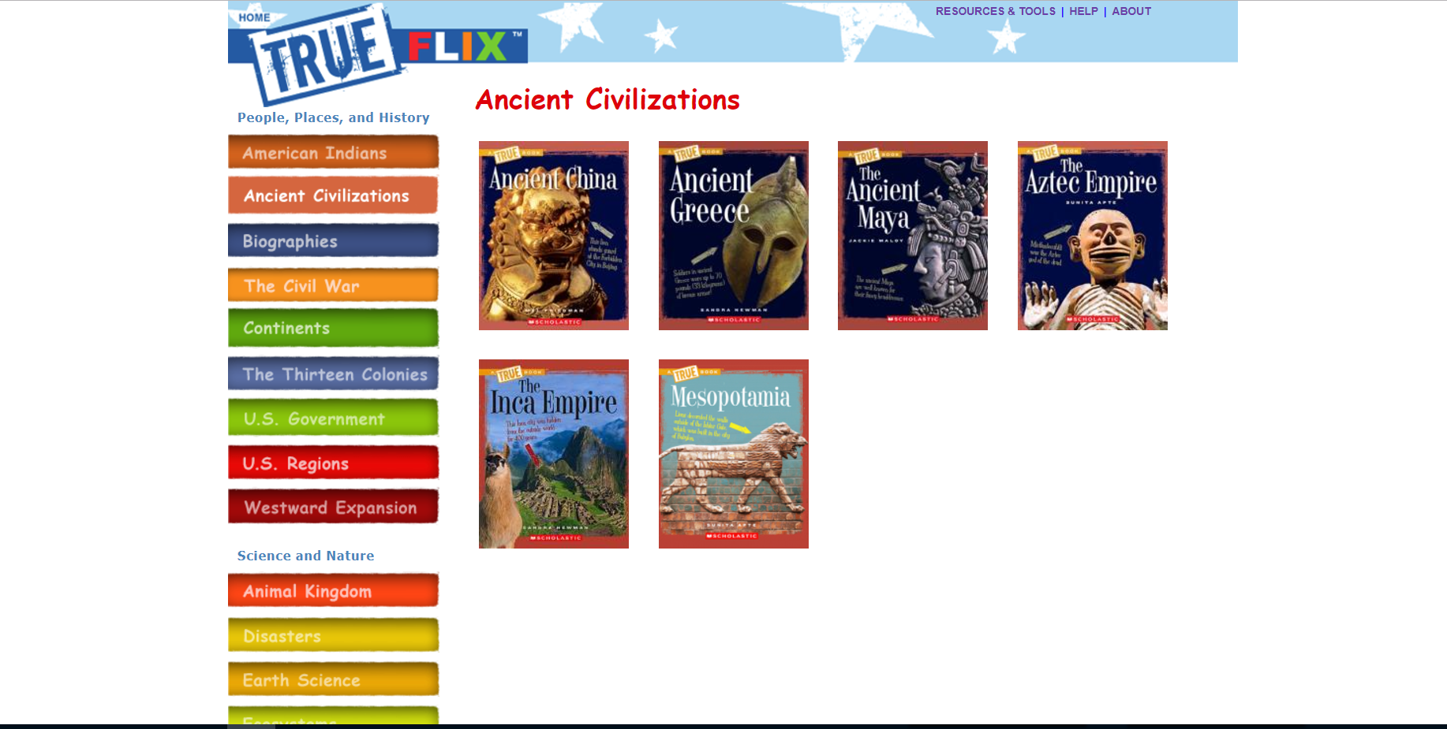
Easy navigation to a different unit
Titles within a unit
Notes:
Multiple titles within a unit. Can skip to a different category or unit easily.

Slide 26
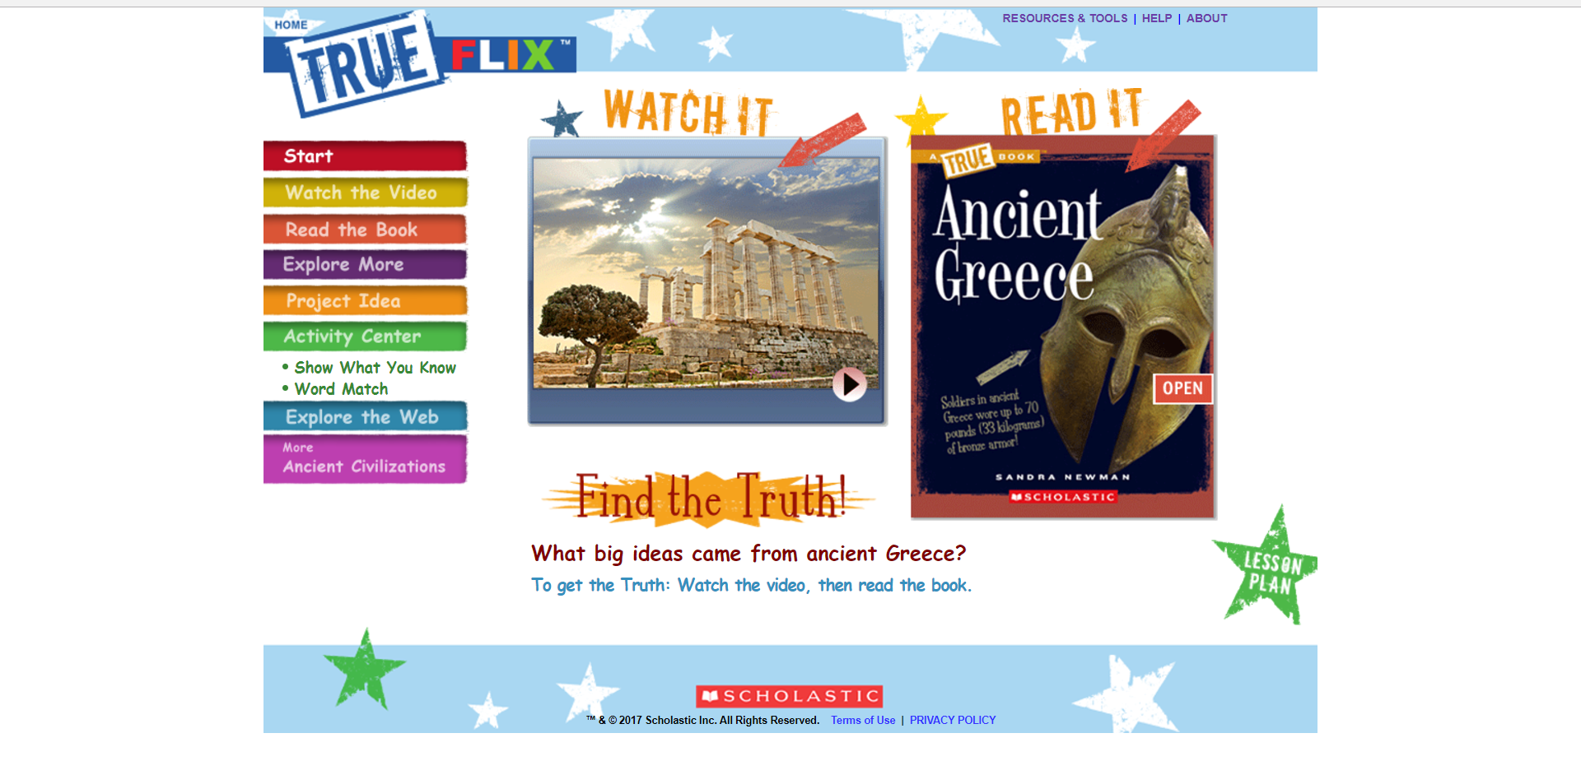
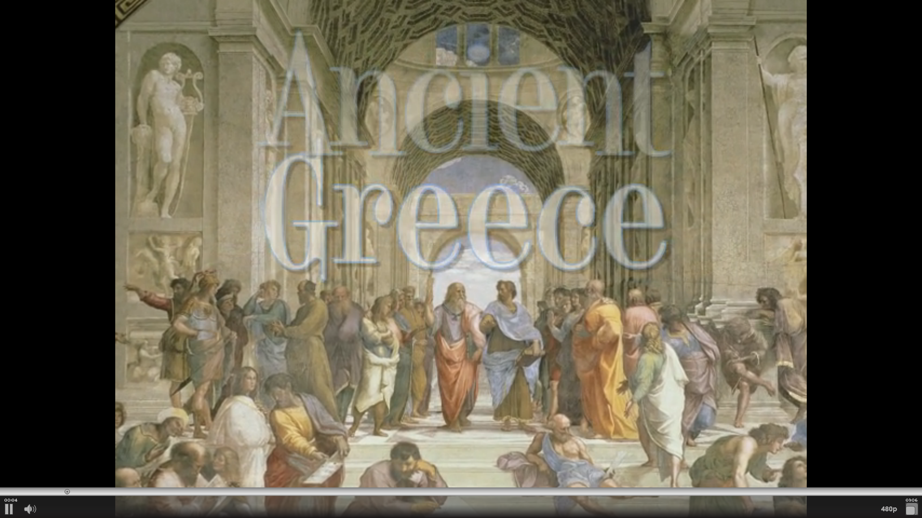
Watch It
Notes:
Watch it: ~1 minute attention-grabbing video to introduce topic

Slide 27
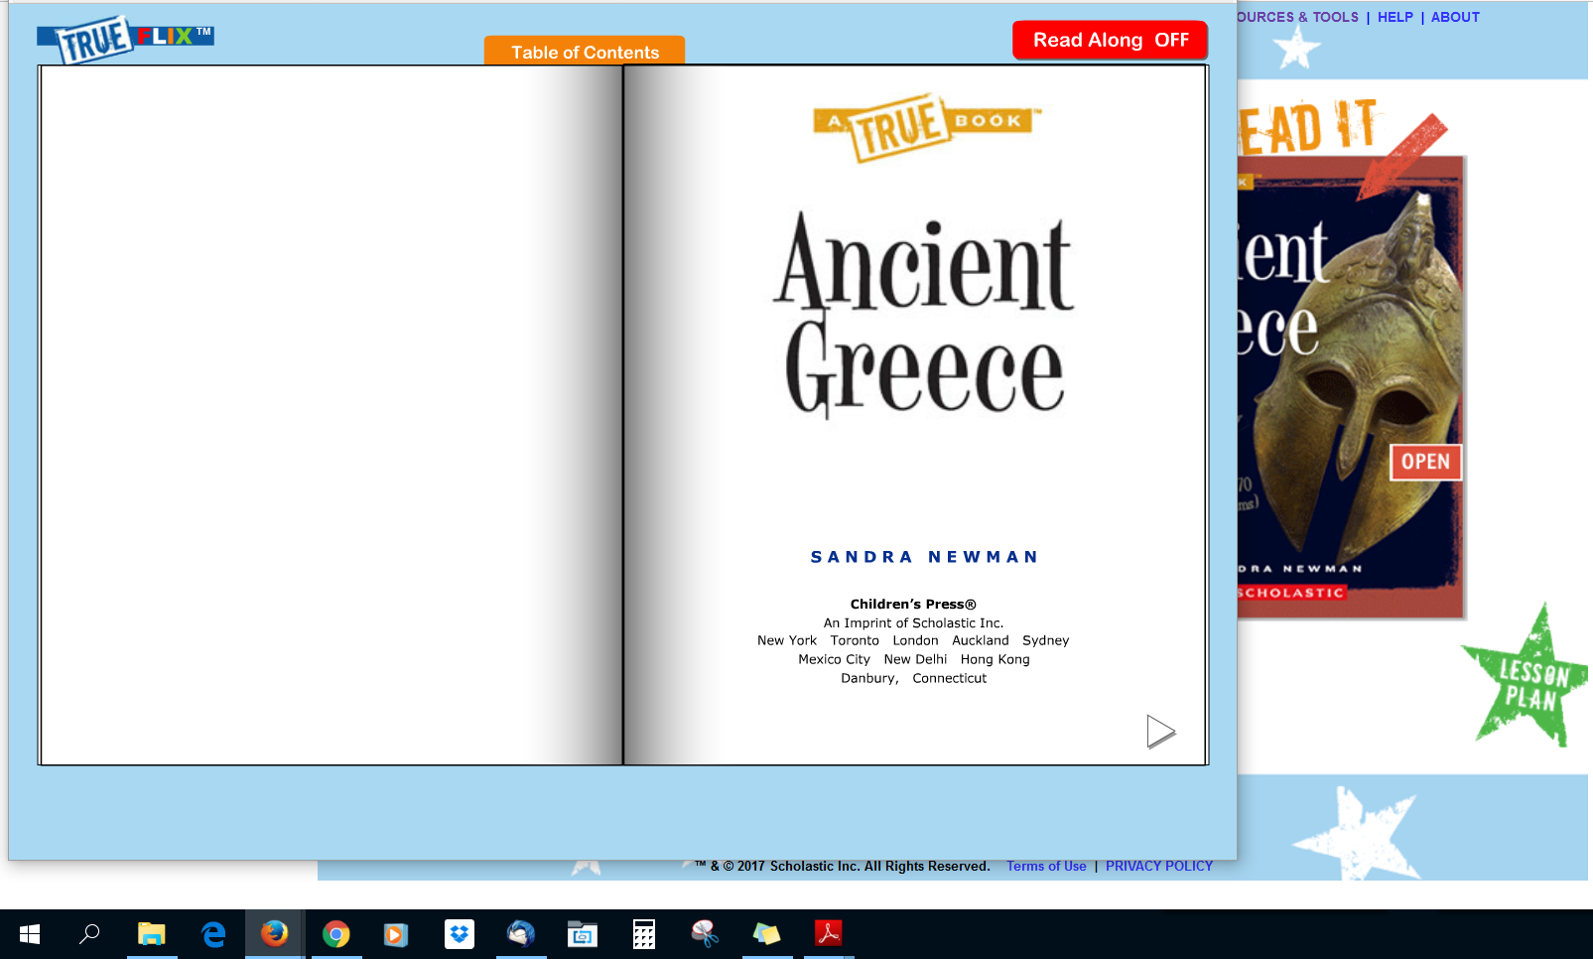
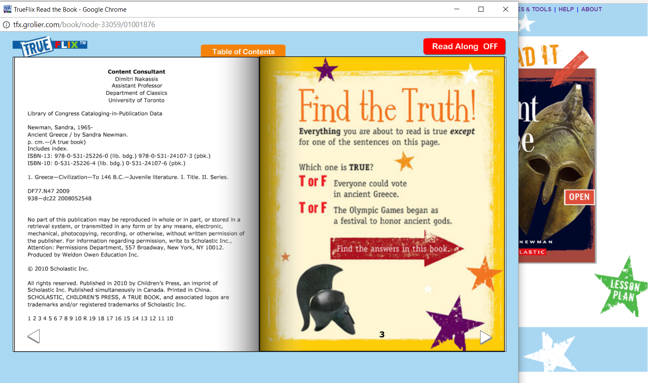
Read It
Flipbooks contain title page information just as a print book
Notes:
Title page information just as a print book has

Slide 28
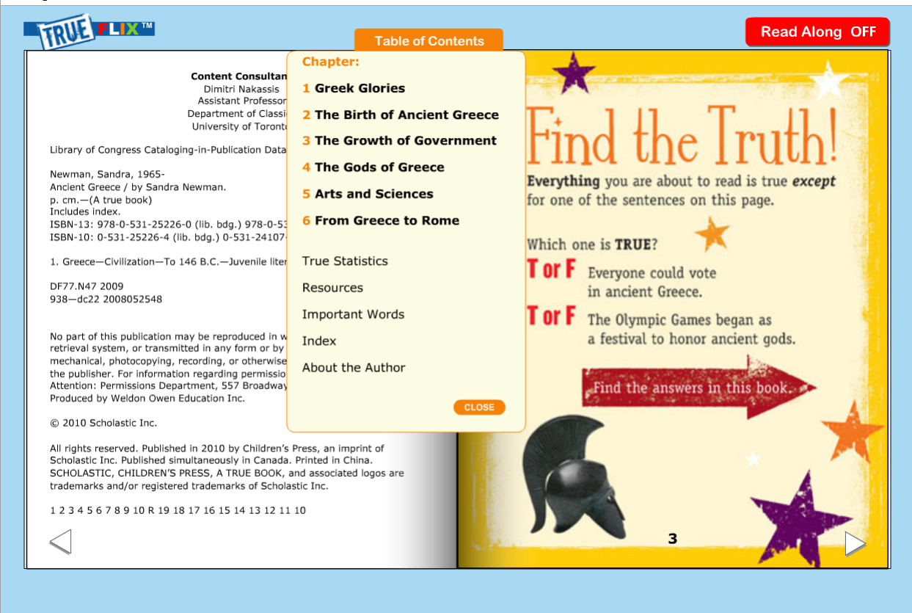
Table of Contents
Interactive Table of Contents
Notes:
Table of Contents tab for easy navigation through book

Slide 29
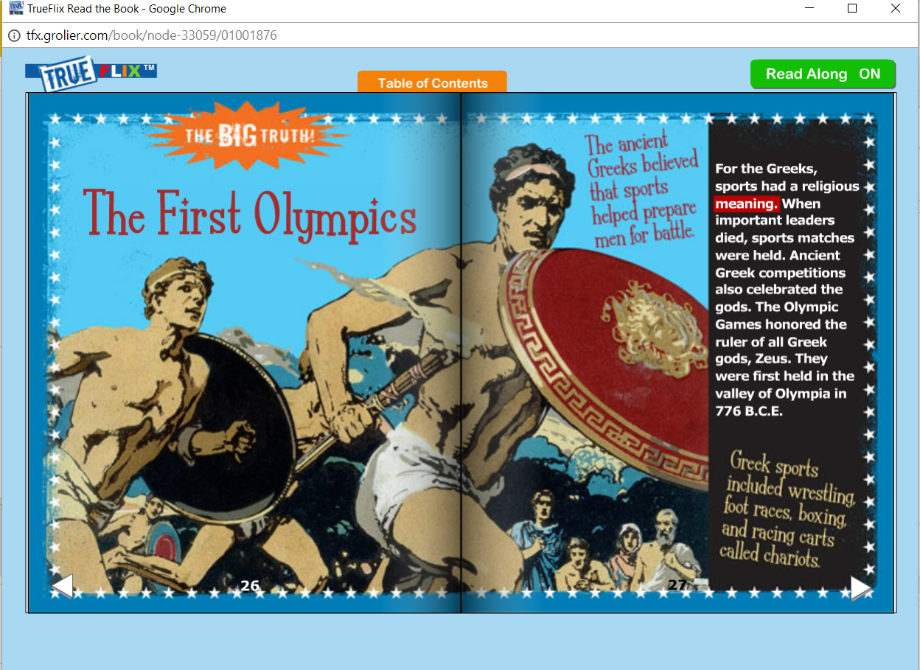
Read Along
Optional Read Along
Word-by-word highlighting
Notes:
Read Along feature can be turned off or on. Words are highlights as they are read so students and patrons can follow along. Great for emerging readers, struggling readers, and English Language Learners.

Slide 30
Built-in Dictionary
Hover over a highlighted word to show definition.

Slide 31
Glossary and Index
Highlighted words in text are included in glossary
Bold page numbers in Index indicate an illustration
Index page numbers are not links
Notes:
Features a glossary and index. Highlighted words in text are included in glossary. Hovering mouse over highlighted word displays definition.

Slide 32
True Statistics
Interesting statistics relevant to book
Did You Find the Truth?

Slide 33
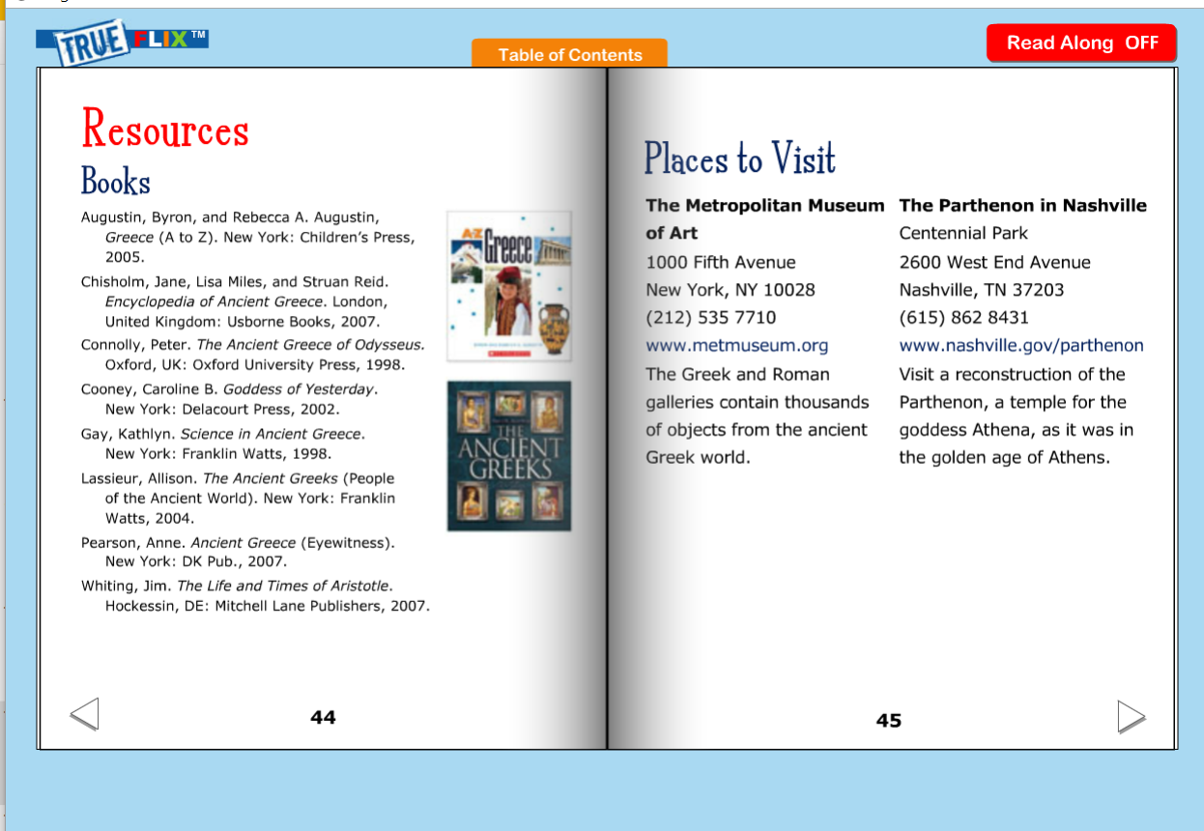
Resources and Places to Visit
Information for further information
Books
Places to visit
Notes:
Resources at end of book--further exploration on topic

Slide 34
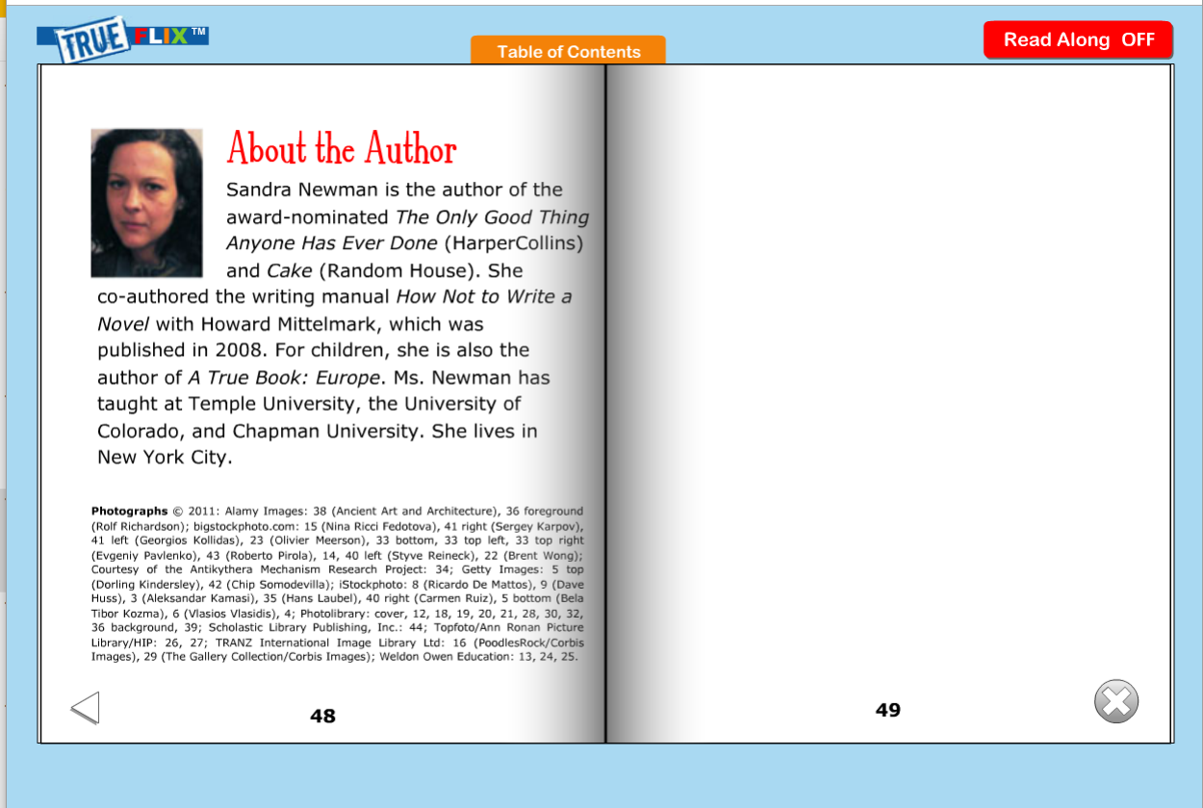
About the Author
Notes:
About the Author feature

Slide 35
Additional Features
Notes:
Features included with each title

Slide 36
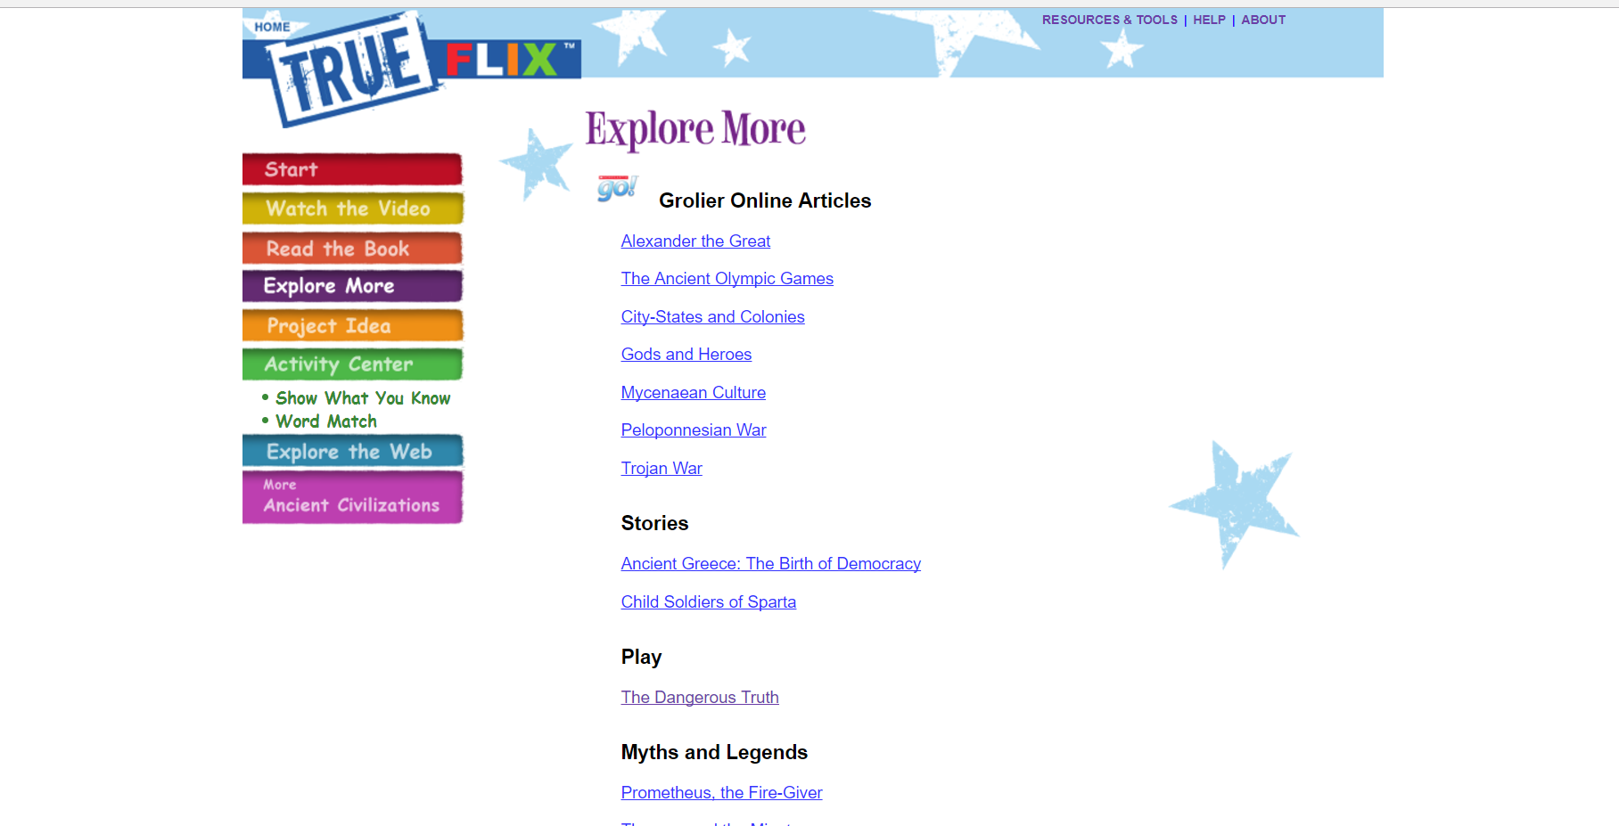
Explore More
Notes:
Additional information related to title topic--all content opens in TrueFLIX window

Slide 37
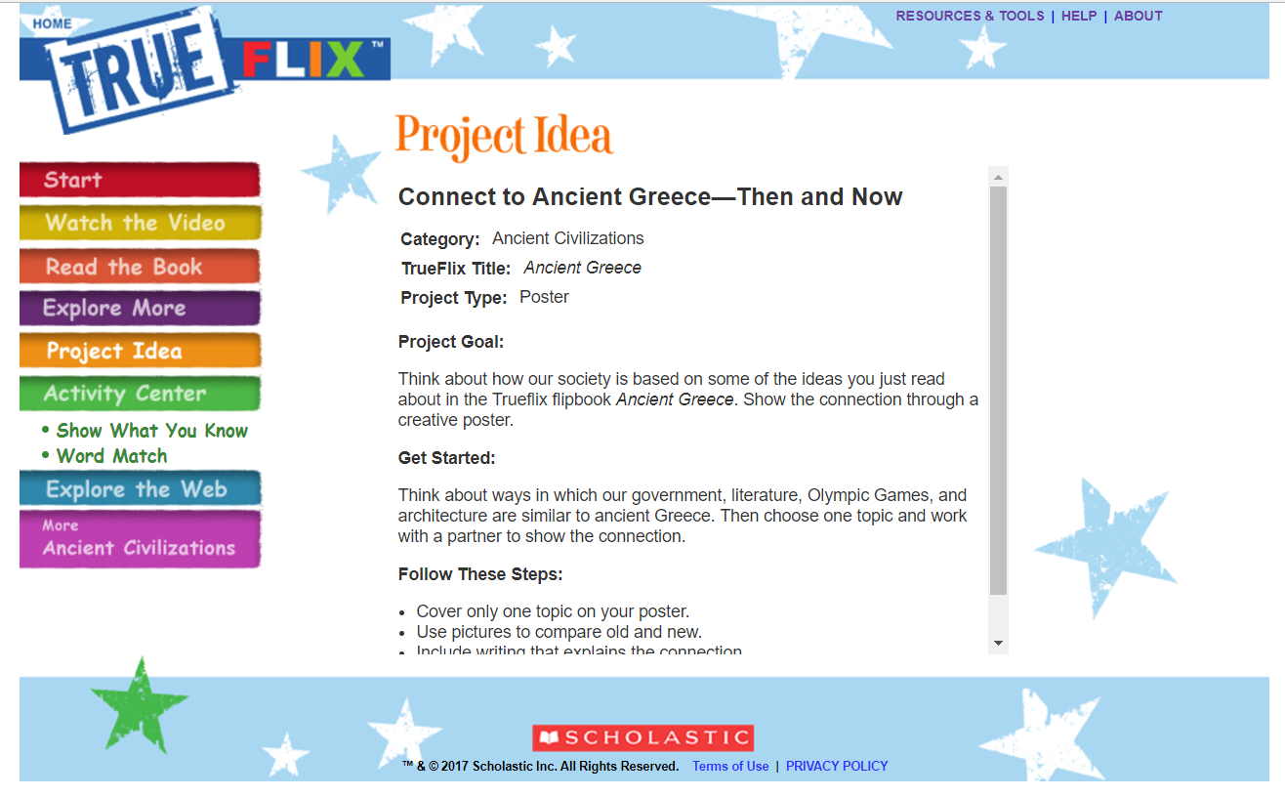
Project Idea
Project goal and questions for beginning research
Notes:
Project idea--directed toward student/patron but librarian/teacher could use this as an assessment or activity

Slide 38
Show What You Know
Short quiz to test knowledge on subject
Can be used as a soft assessment
Notes:
Fun, short quiz to test the knowledge gained from book.

Slide 39
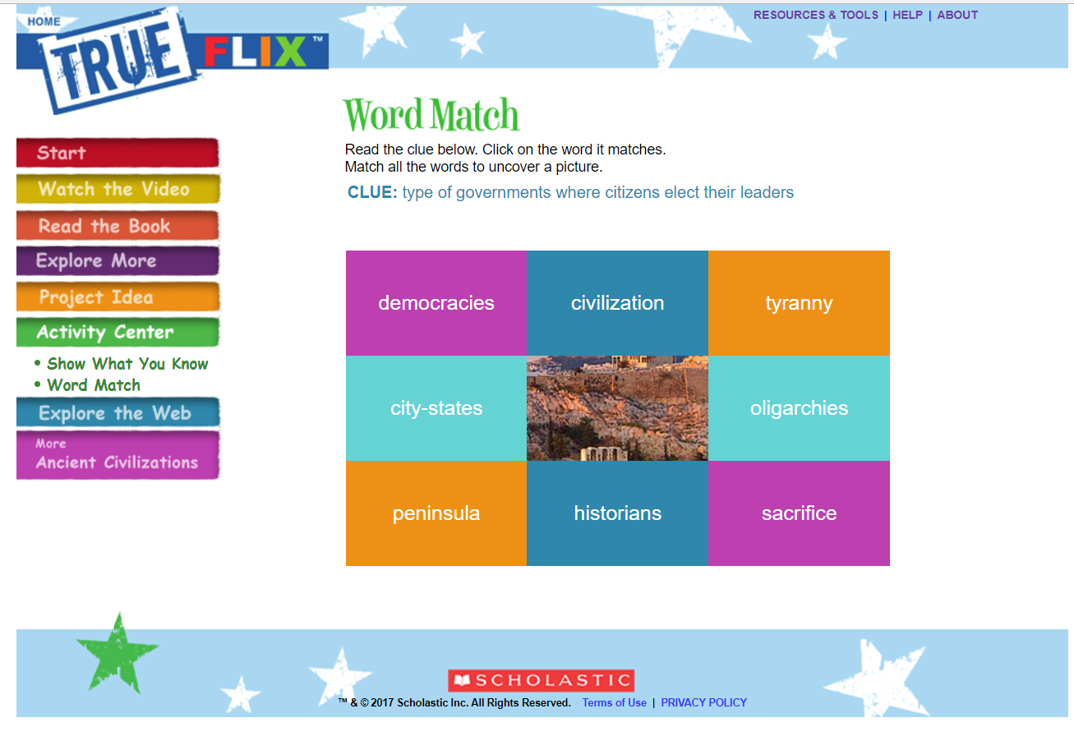
Word Match
Vocabulary Builder
Based on important words found in book
Notes:
Another fun activity to complete after reading the book. Tests vocabulary knowledge.

Slide 40
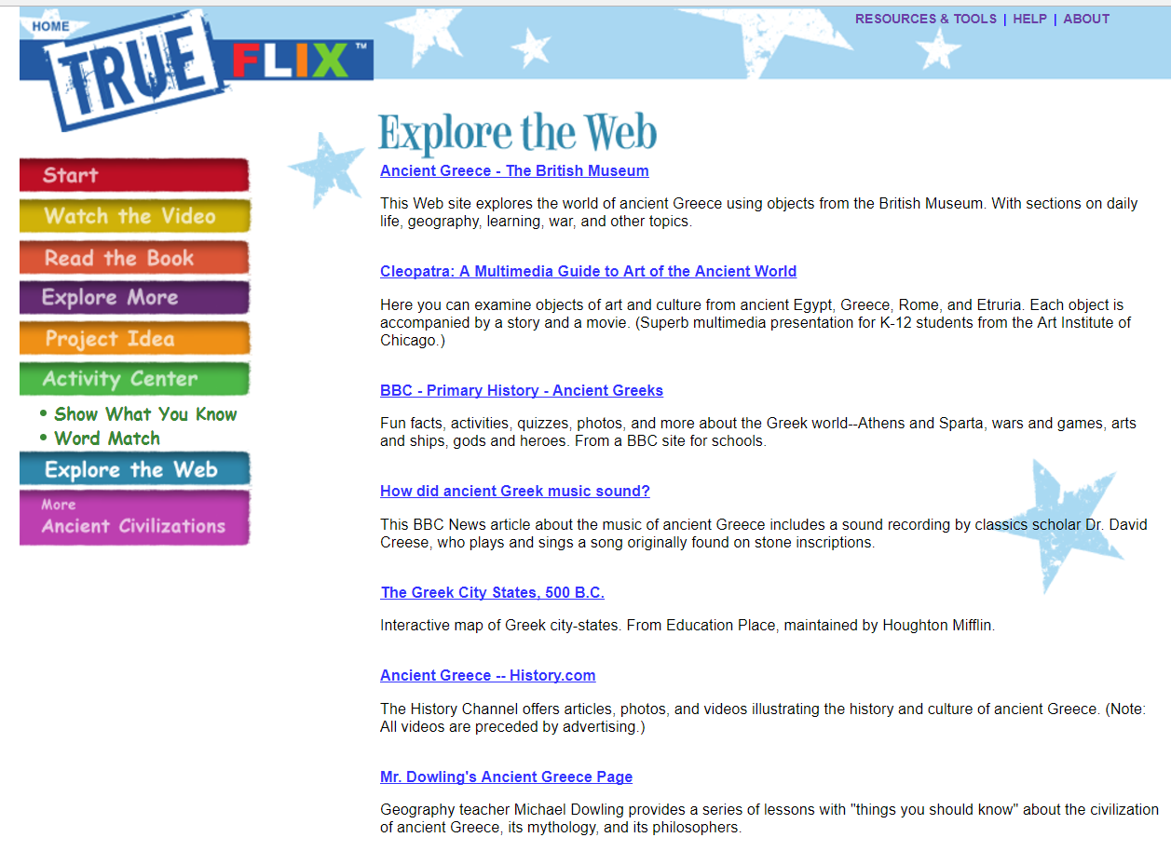
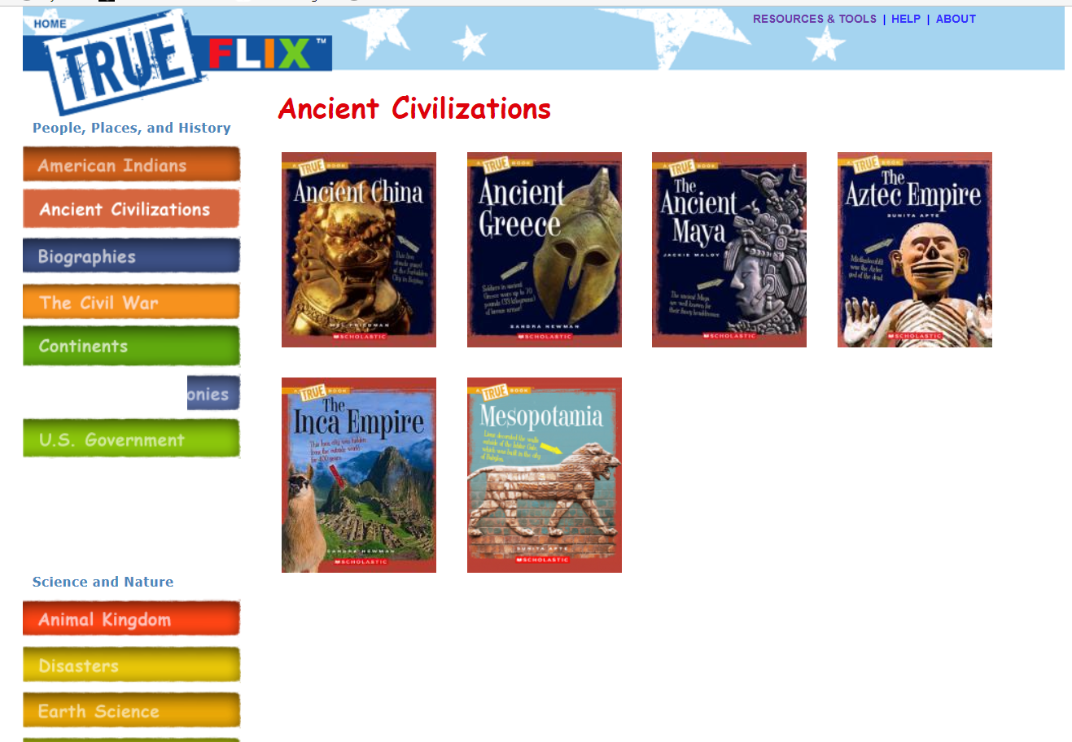
Explore the Web
Vetted, age appropriate websites for further exploration on the topic.
“More…” takes you back to additional titles in unit
Notes:
Vetted websites that are relevant and age appropriate are also included. Clicking on “More Ancient Civilizations” will take you back to all of the titles availablefor that category

Slide 41
Lesson Plan
Complete lesson plans available for every title
Notes:
A lesson plan is included for each title

Slide 42
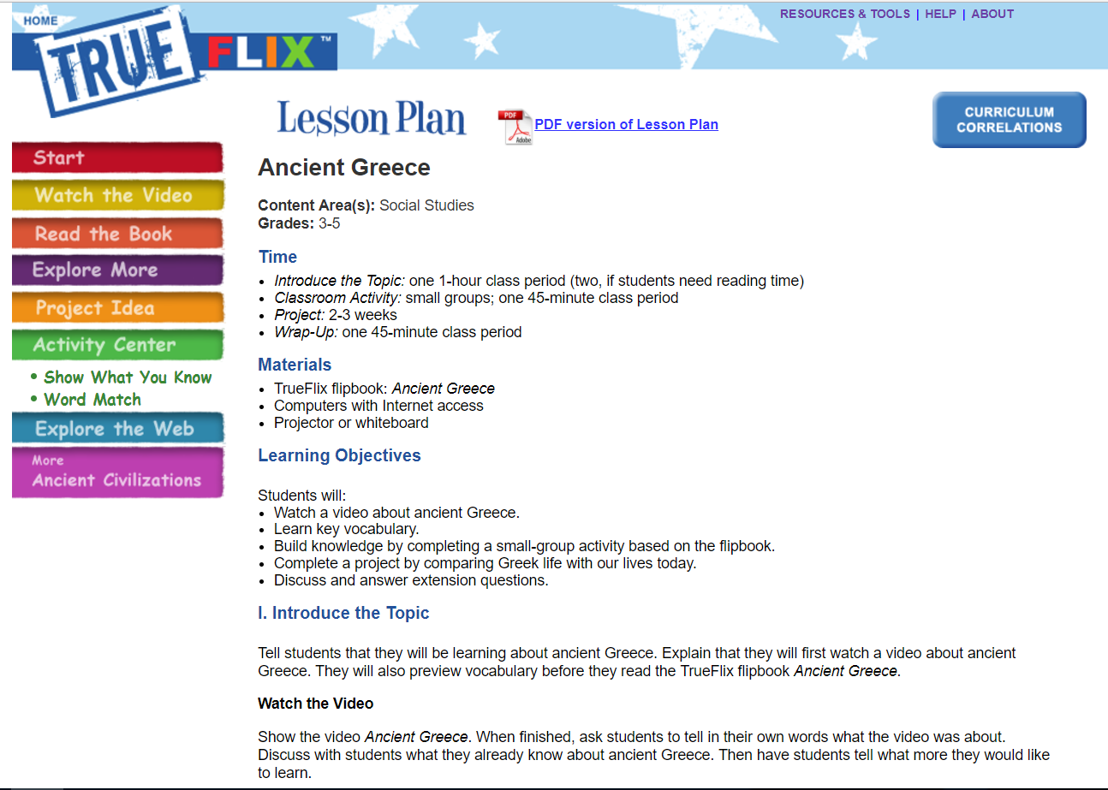
Lesson Plan
Lesson plan features:
Time needed
Materials
Learning Objectives
Introduction
Classroom activity
Project idea
Extension activities
PDF version available
Notes:
Online and PDF version of lesson plan--everything wrapped in nicely in one area and covers everything needed

Slide 43
Curriculum Correlations
Notes:
Curriculum Correlations tab

Slide 44
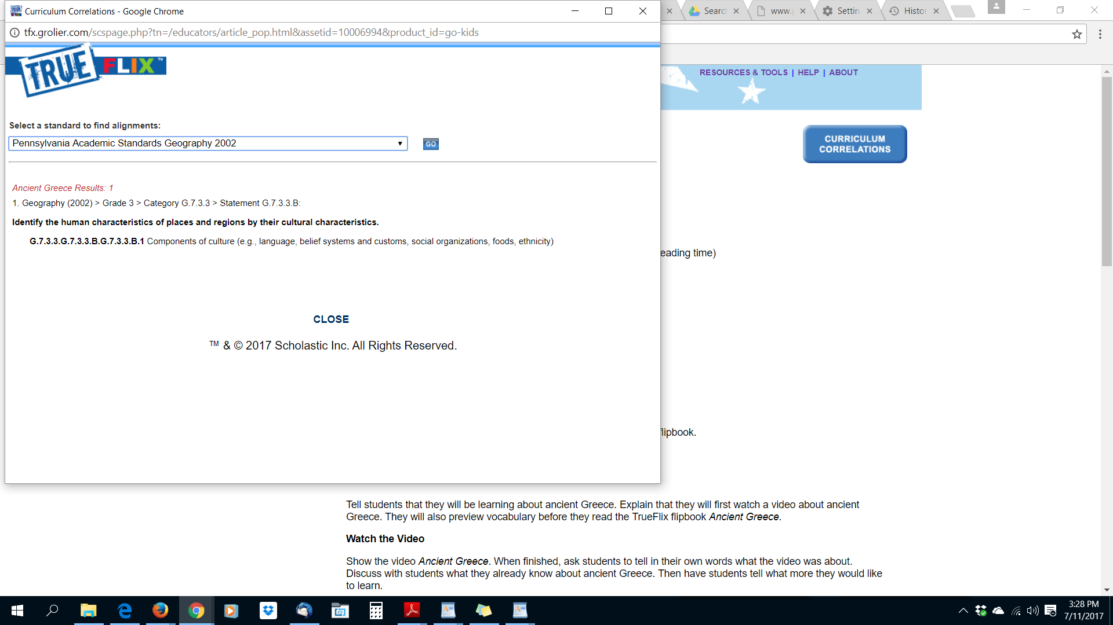
Standards are tied to each title, and accessible from the Lesson Plan link
Notes:
Academic standards are tied to each title--Accessible by clicking on Lesson Plan link

Slide 45
Curriculum Connections
Drop-down menu to access additional standards
Notes:
Use dropdown menu to choose from other PA standards such as English Language Arts Anchors

Slide 46
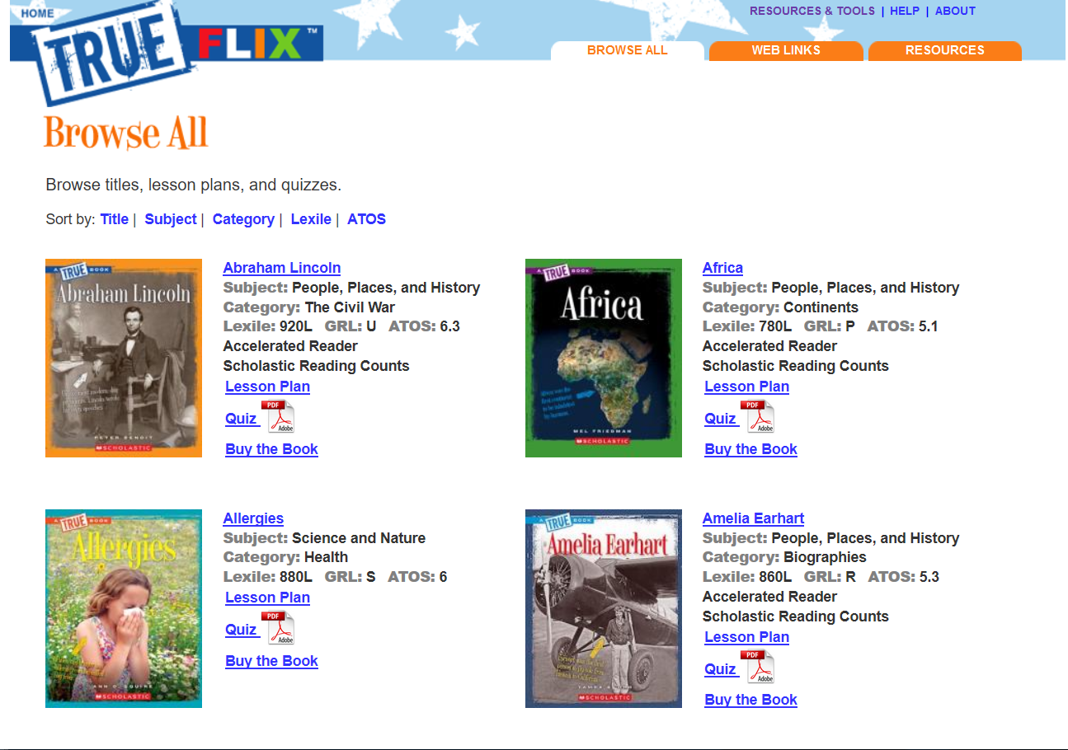
Resources and Tools
Click on Resources and Tools link to access additional features:
Browse All
Web Links
Resources
Notes:
Resources and Tools to access Browse All with sorting, Web Links, and Resources

Slide 47
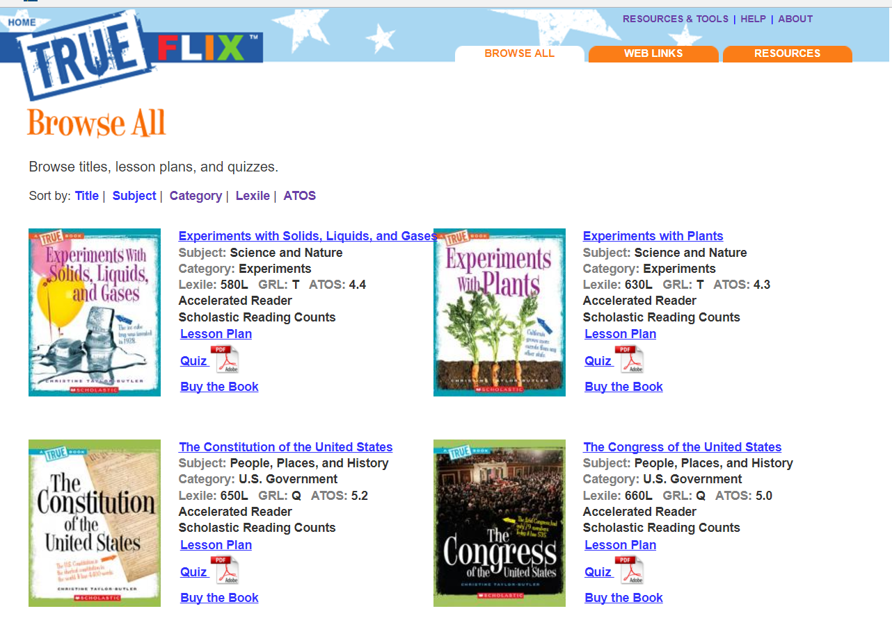
Browse All
Browse by:
Title
Subject
Category
Lexile
ATOS (text complexity)
Can also see if a title is included in Accelerated Reader and Reading Counts

Slide 48
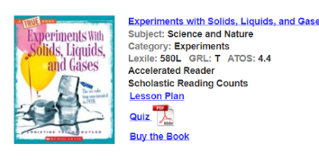
Printable “Show What You Know” quiz
Notes:
If you want to use the “Show What You Know” as a graded assessment, the quiz can be printed out.

Slide 49
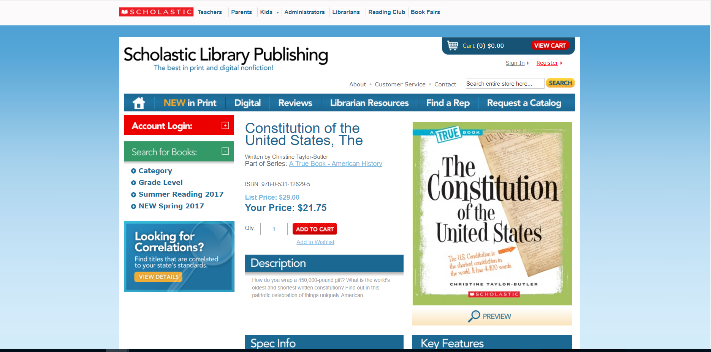
Buy the Book
Notes:
“Buy the Book” will take you to the Scholastic website to purchase the print book.

Slide 50
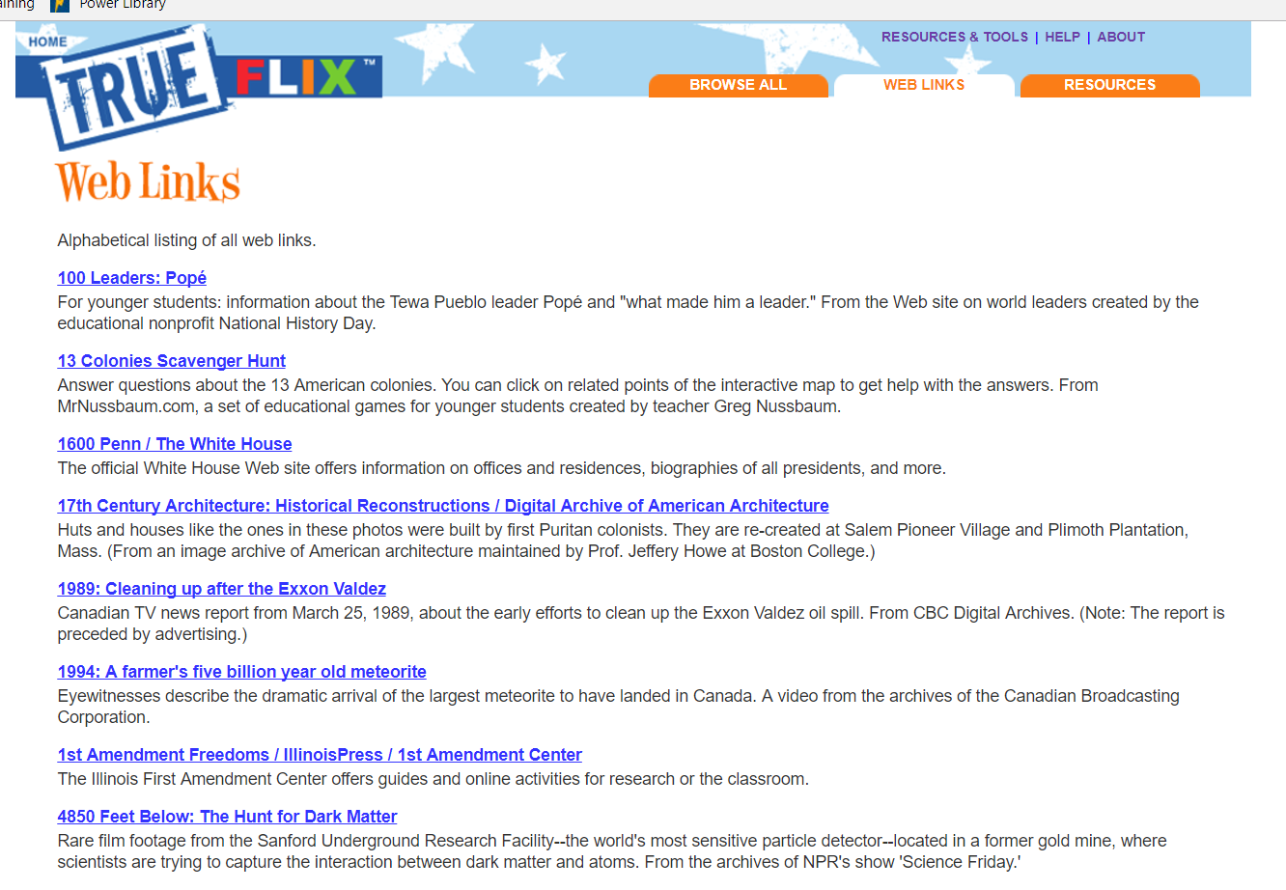
Web Links
Alphabetical listing of all websites included in TrueFLIX

Slide 51
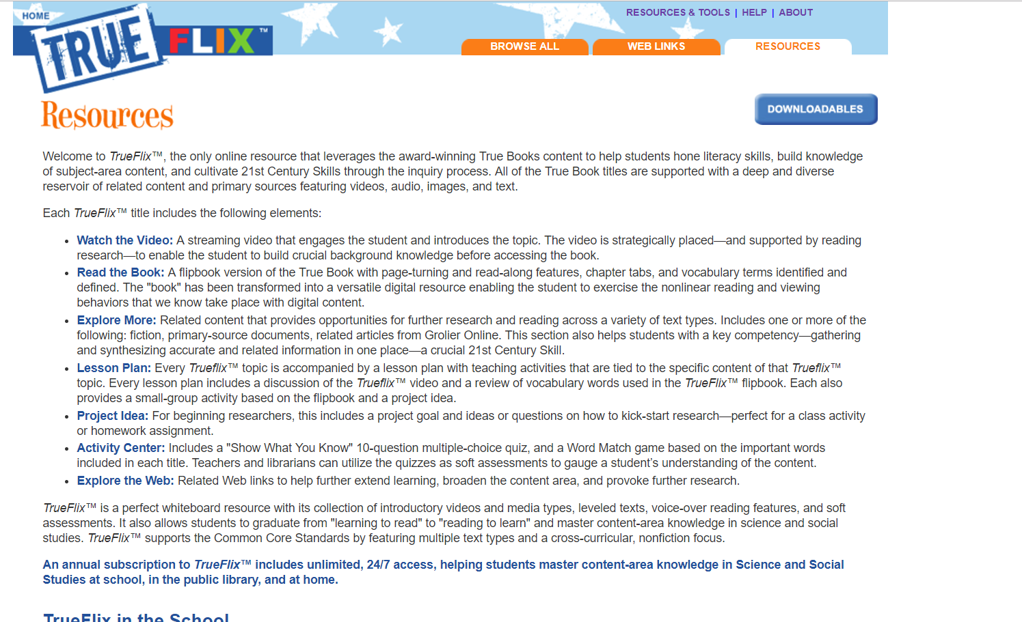
Resources
Information about the elements included in TrueFLIX

Slide 52
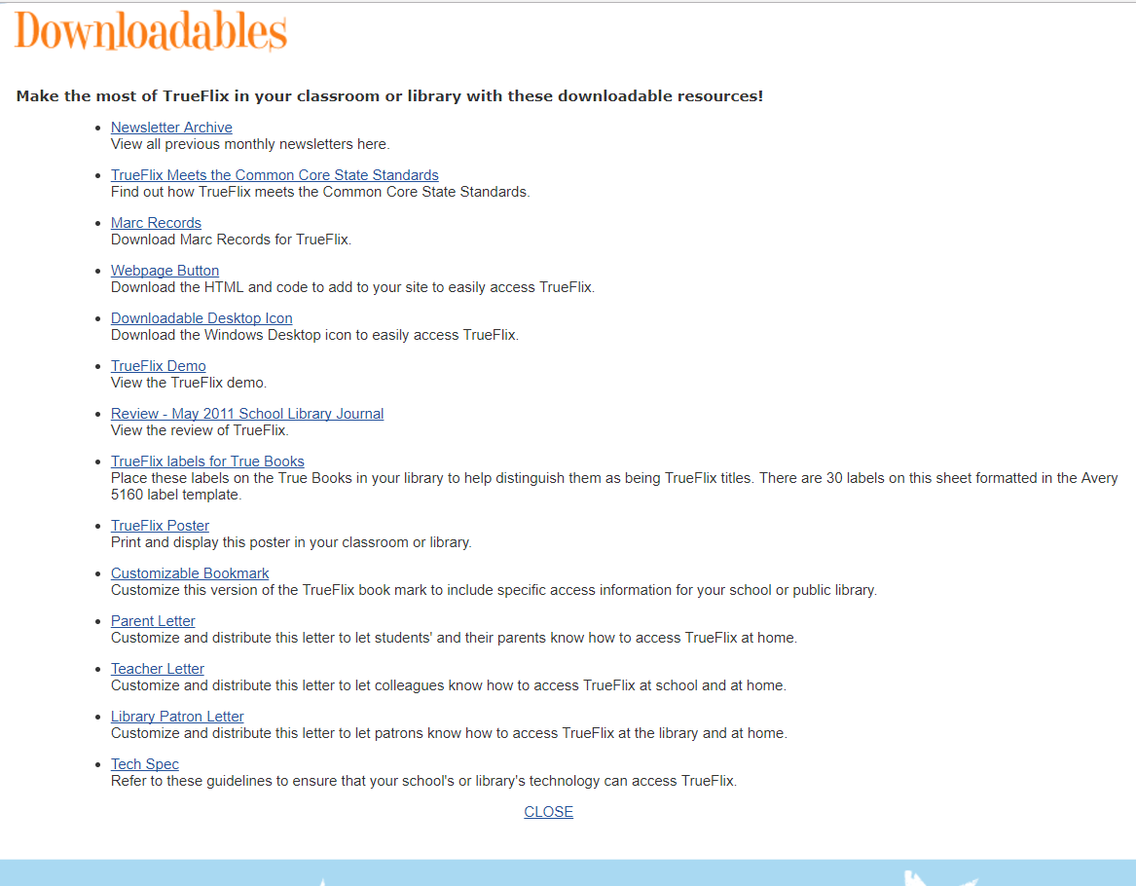
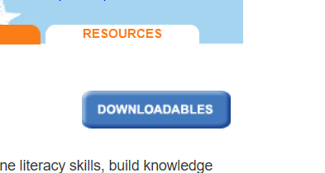
Downloadables
Newsletters
MARC records
Customizable letters
and more!
Notes:
Downloads button is accesible under the Resources tab. A variety of downloadable resources: MARC records, webpage button, desktop icon, letters to parents, teachers, patrons, etc.

Slide 53
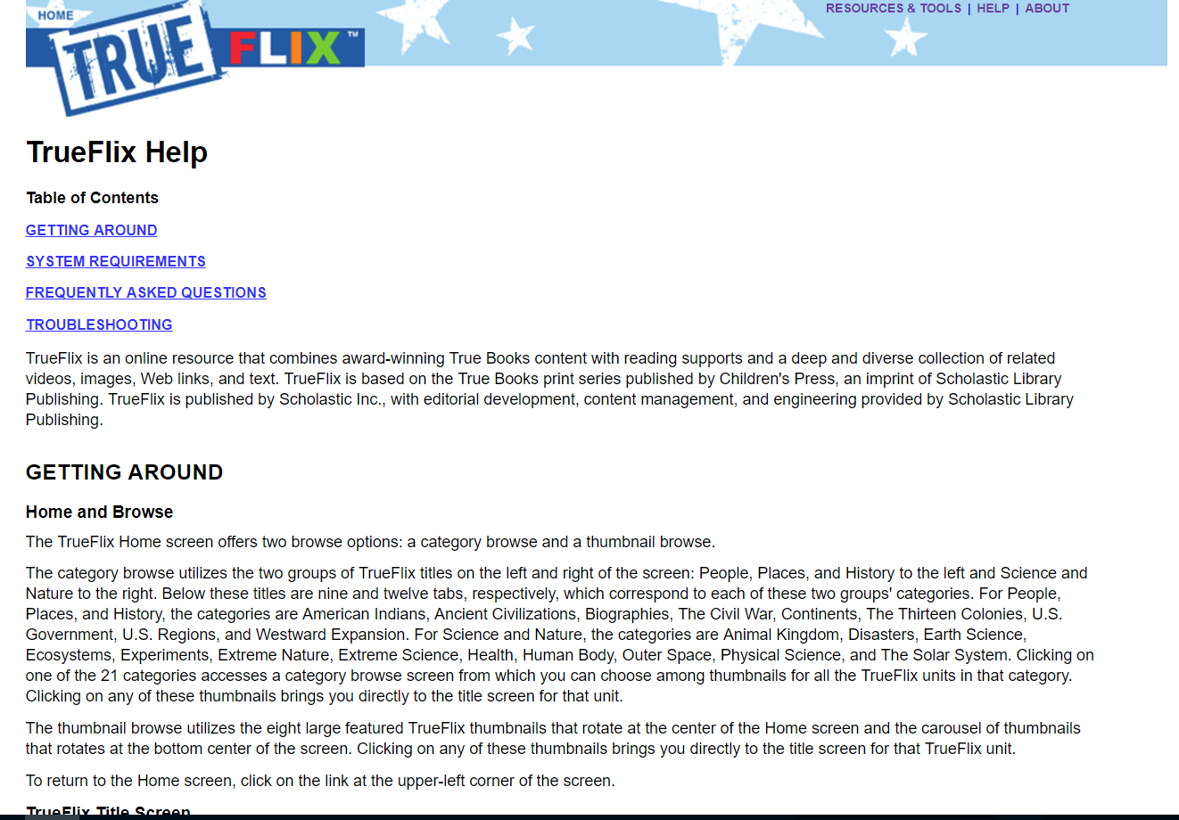
Help

Slide 54
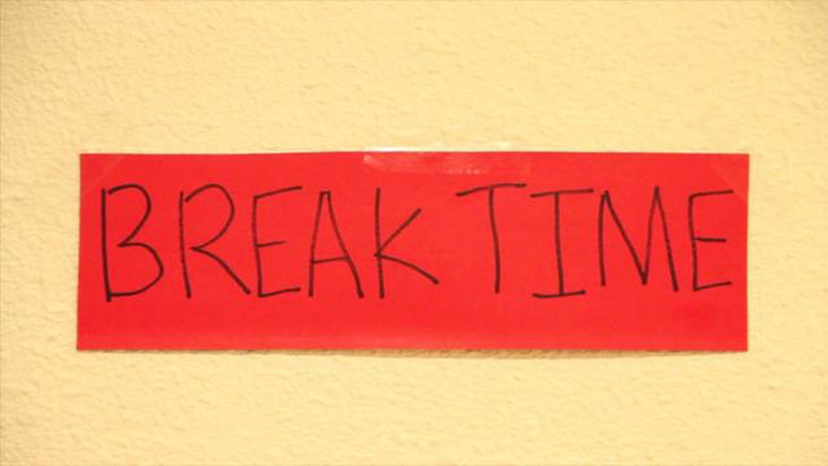
15 minute break

Slide 55
BookFLIX
Geared towards students in PK through grade 3
Unlimited, simultaneous access
Stregthens early literacy skills
Builds fluency, vocabulary, and comprehension
120 fiction and non-fiction pairings
Award-winning Scholastic Imprint fiction books

Slide 56
Main Page
Featured Pair
9 Categories
Animals and Adventure
Earth and Sky
People and Places
ABC’s and 123’s
Family and Community
Music and Rhyme
Adventure
Celebrations
Imagination

Slide 57
Choosing a Category
View pairings easily
2 ways to navigate pages of pairings:
“Turn Page” link
Tabbed pairing listing on right side of page
Notes:
Clicking on a category provides a listing of all paired books. Easy to navigate using “turn page” at the bottom, or use the pair listings on right side.

Slide 58
Pairing
Fiction and non-fiction pairing
Static left menu
Watch the Story!
Read the Book!
Puzzlers!
Meet the Author
More--back to category pairings

Slide 59
Watch the Story
Spanish is available for some titles (Español button)
Optional Read Along (closed captioning)
Full screen viewing
Notes:
Animated version of picture book playing. Features: choose Spanish, turn read along off/on (closed captioning for read along), full screen viewing

Slide 60
Read the Book
Notes:
Click on “Read the Book” to open the paired non-fiction book

Slide 61
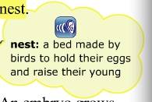
Read the Book
Spanish version
Optional Read Along
Highlights text as it’s read
Definitions provided with pronunciation
Notes:
Spanish version is available, Read Along off/on (words highlighted as it’s read, hovering over yellow highlighted word will provide a definition and pronunciation

Slide 62
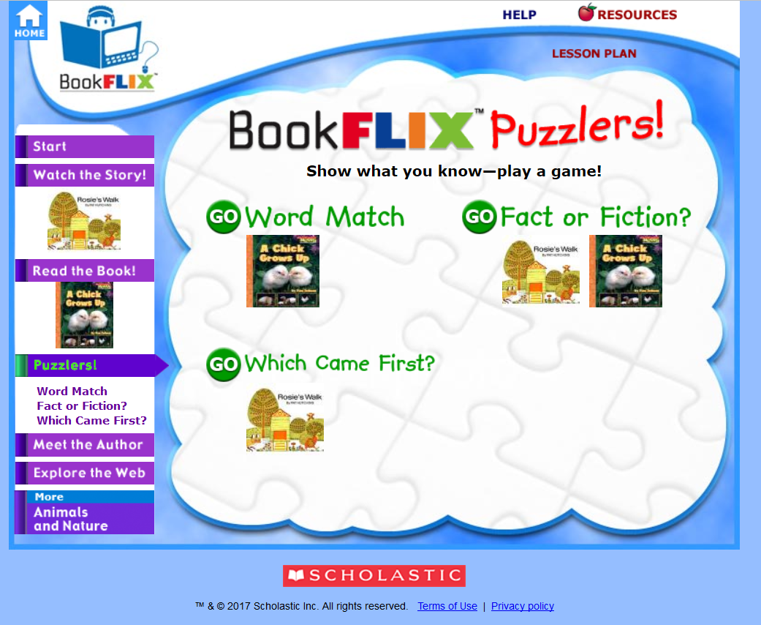
Puzzlers
Word Match (vocabulary)
Fact or Fiction?
Which Came First? (sequencing)

Slide 63
Word Match
Vocabulary builder
Listen to the instructions and questions

Slide 64
Fact or Fiction?
Hint button
Listen to instructions and prompt
Visual cues
Notes:
Visual cues—look at the chickens by “Fact” and “Fiction” answers

Slide 65
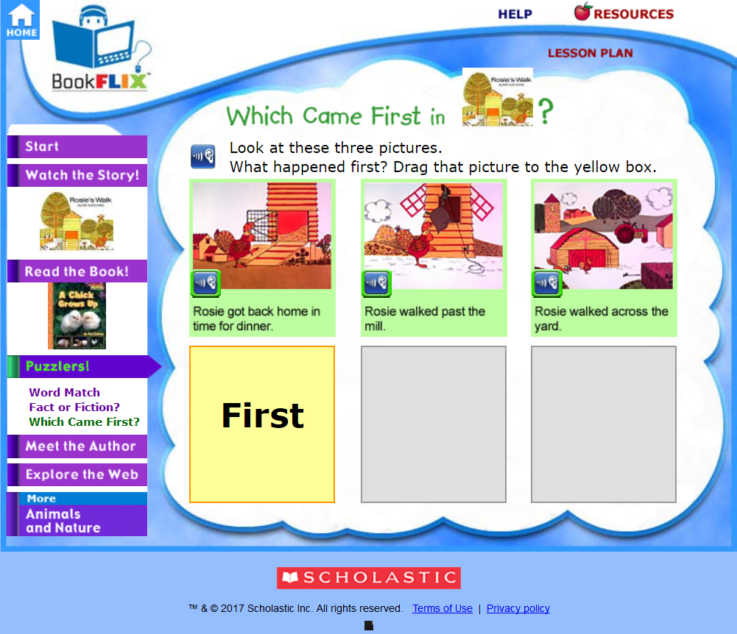
Which Came First?
Drag and drop the boxes
Teaches sequencing skills

Slide 66
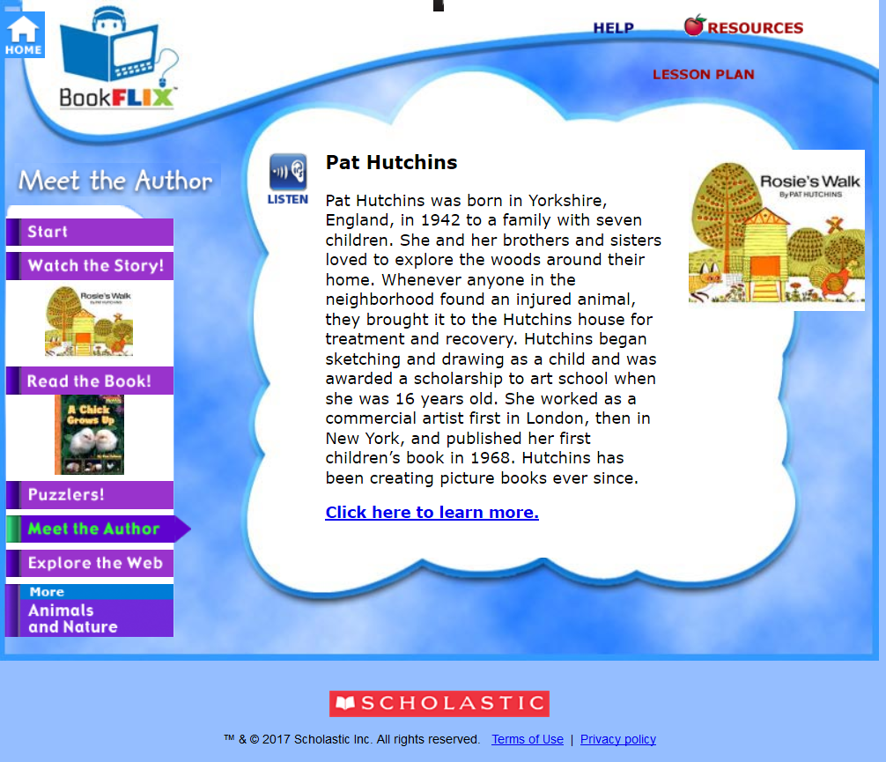
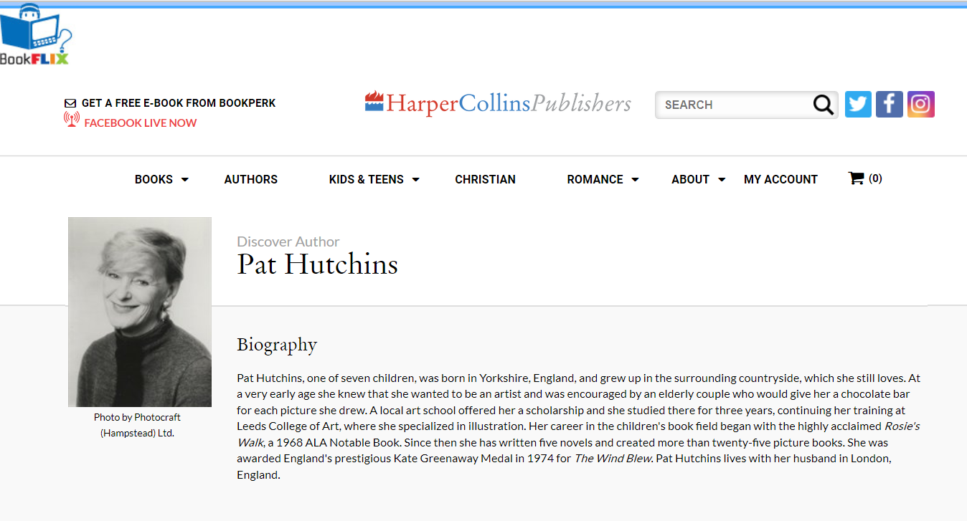
Meet the Author
Author information on BookFLIX site
“Click here to learn more” to go to author website
Notes:
Click on “Click here to learn more” to get more information about author from author websites.

Slide 67
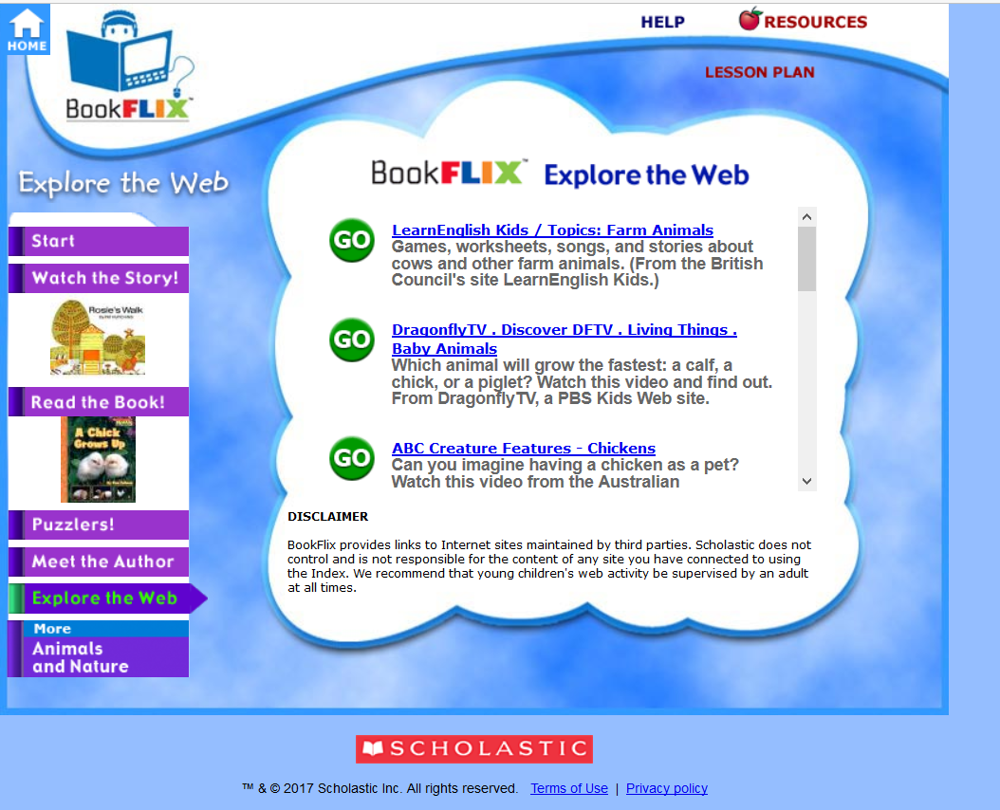
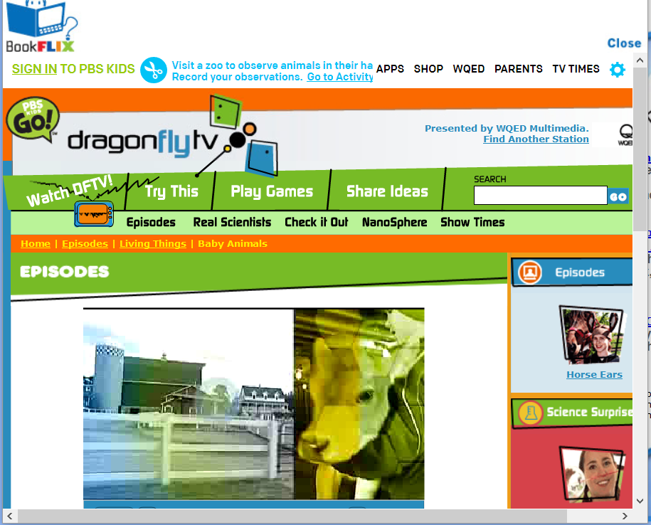
Web Resources
“More…” takes you back to pairings in category
Notes:
Additional web resources relevant to topic. Clicking on “More Animals and Nature” will take you back to the pairings available.

Slide 68
Lesson Plan
Lesson plan link is available on every screen

Slide 69
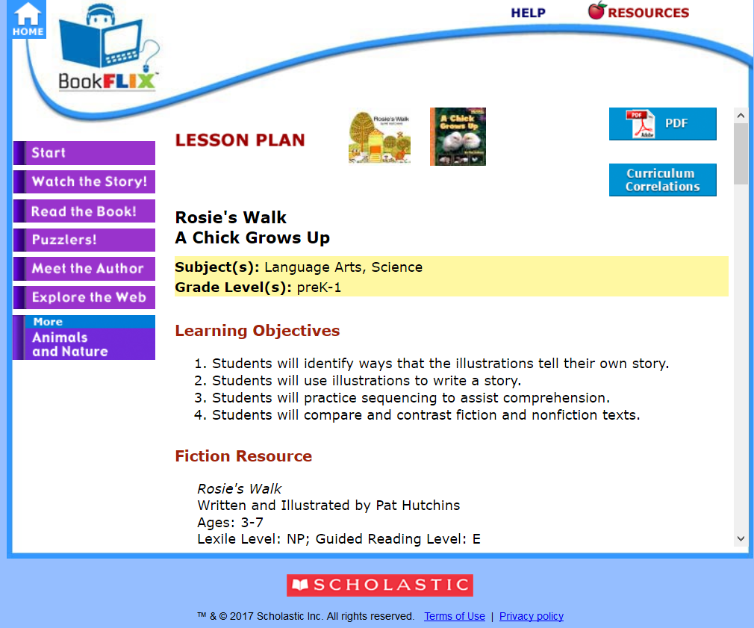
Lesson Plan
Learning Objectives
Fiction Resource
Non-fiction Resource
Before Viewing the Video
After-Viewing Activities
Paired-Text Activities
Further Research
Assessment
PDF version available
Notes:
PDF version of the lesson plan is also available

Slide 70
Lesson Plan
Title information for both fiction and non-fiction titles

Slide 71
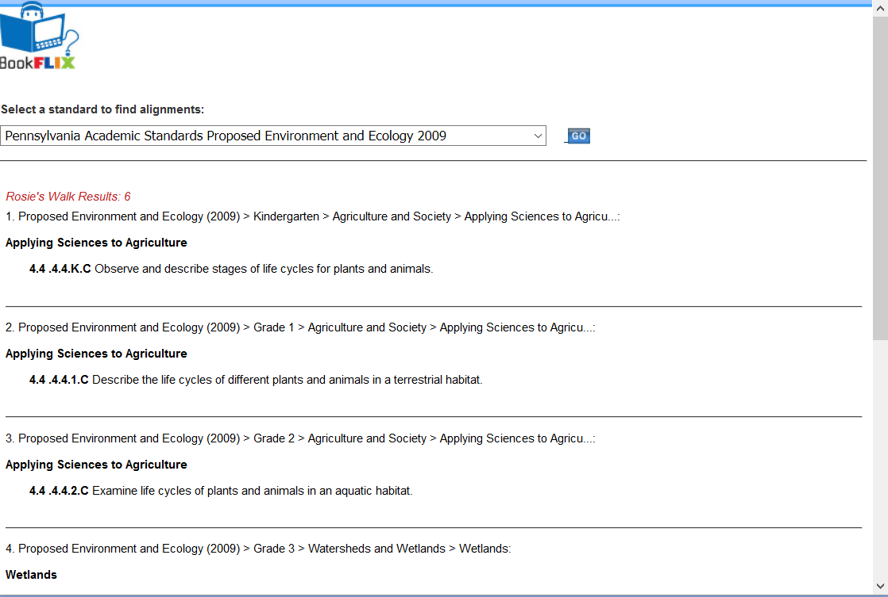
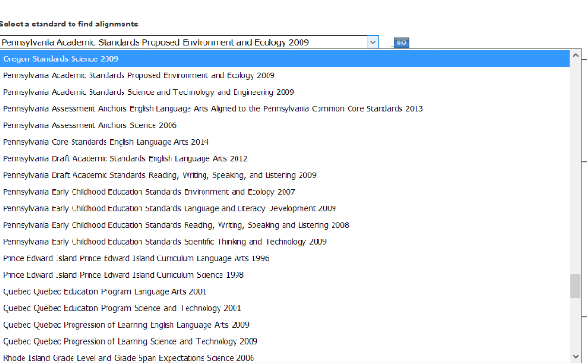
Curriculum Correlations
Notes:
Drop down menu for the various PA standards just like TrueFLIX

Slide 72
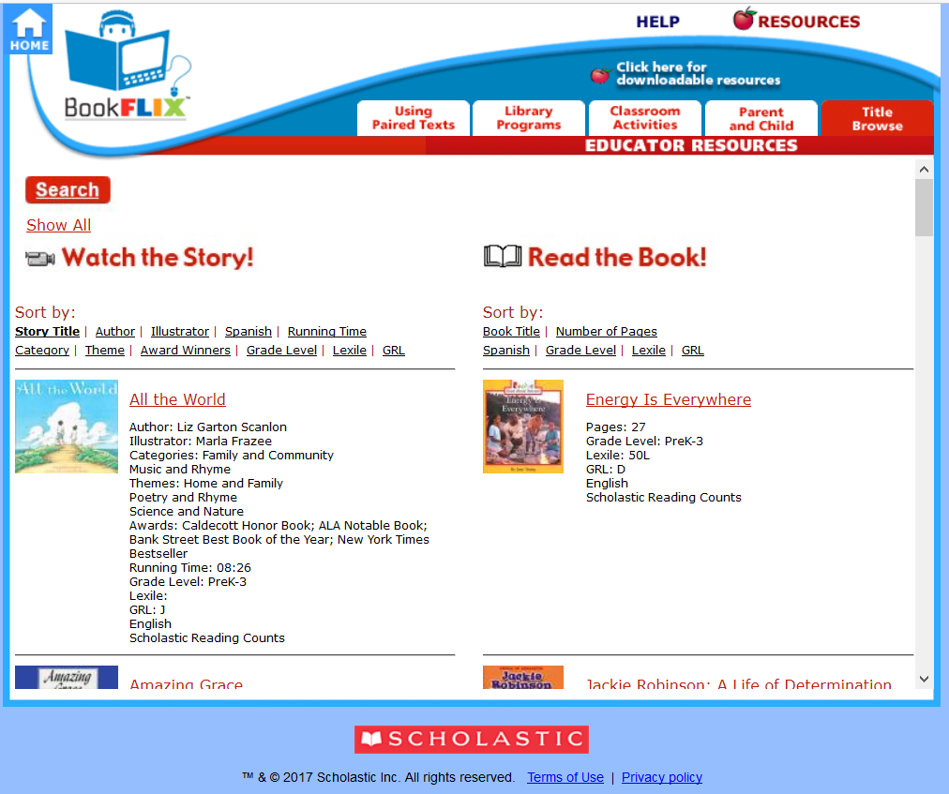
Resources Tab
Title Browse tab
Sort by
Video:
Title
Author
Illustrator
Spanish
Running time
Category
Theme
Award Winners
Grade Level
Lexile
GRL
* Also indicates if title is part of Reading Counts
Book:
Title
Number of Pages
Spanish
Grade Level
Lexile
GRL
Notes:
Clicking on Resources link automatically takes you to the “title browse” tab

Slide 73
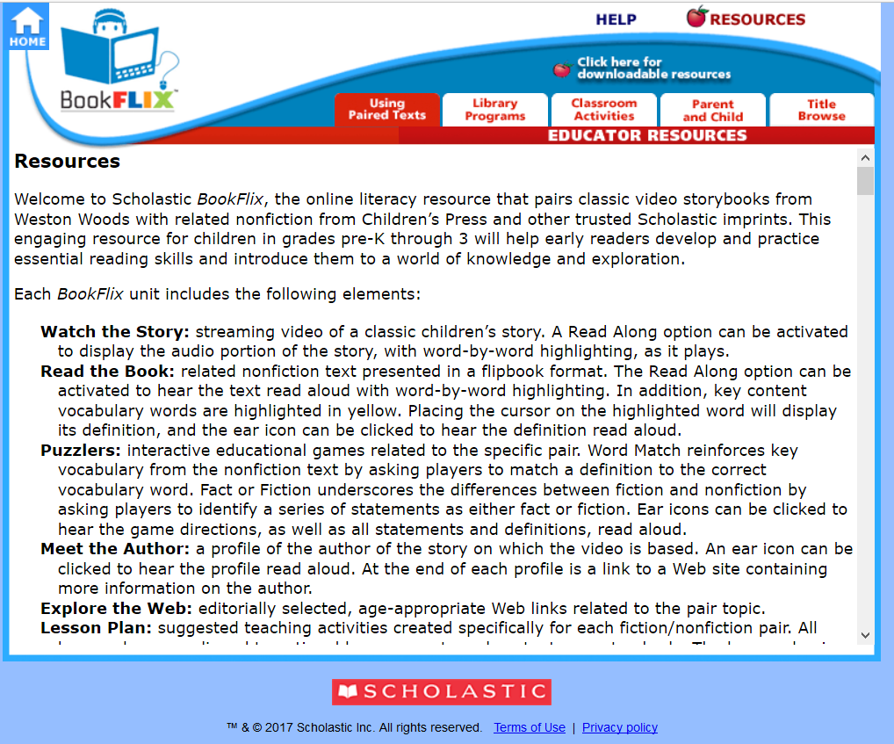
Using Paired Texts
Provides information on the elements of each unit
Provides information included in the Library Programs, Classroom Activities, and Parent and Child tabs

Slide 74
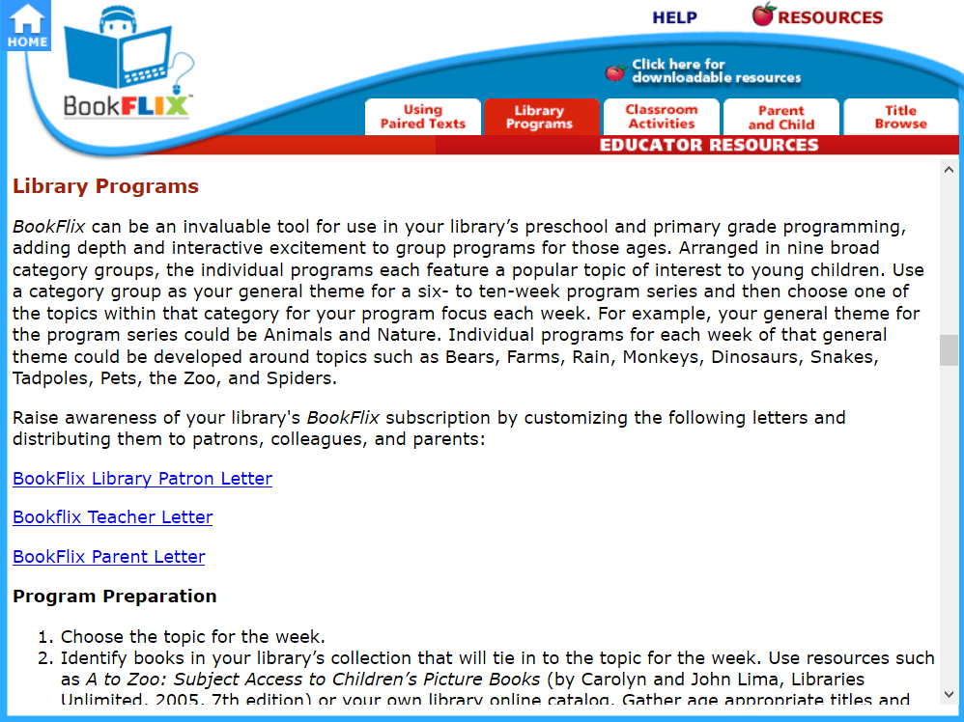
Library Programs Tab
Printable Letters
Program Preparation
Program Presentation
Independent Learning

Slide 75
Classroom Activities Tab
General Strategies and Activities
Activities by Theme

Slide 76
Parent and Child Tab
Ideas for BookFLIX use at local libraries, and from home.

Slide 77
Downloadables
Accessed from Resources Tab

Slide 78
Downloadables
MARC records
Desktop Icon
Customizable Letters
Printables
and more!

Slide 79
Bookmarks and Poster

Slide 80
Help
Pair elements features
System Requirements
FAQs
Troubleshooting
and more

Slide 81
Promotional Materials from POWER Library
For Librarians page → Promotional Materials
https://www.powerlibrary.org/librarians/e-resources/marketingpr
Printable bookmarks, graphics for magnets, posters, and more!

Slide 82
Questions?

Slide 83
Discussion
How might you use these resources for:
Constitution Day?
Black History Month?
Promoting literacy skills in early readers?
To promote award-winning titles?
If you have experience teaching with BookFLIX and TrueFLIX please share your success stories!

Slide 84
Hands-on time!
BookFLIX
Use the Browse All feature to see the awards for each title
Pick a theme and check out the pairings (maybe even watch an animated picture book!)
View some of the available lesson plans for pairings
Take a peek at the customizable letters for parents and teachers
TrueFLIX
Choose a unit and look at the lesson plans for some of the titles in that unit
Browse some of the units and take a look at the available titles
Take a look at some of the websites found under the Web Links tab

